Slide 1
USING TECHNOLOGY TO IMPROVE STUDENT LEARNING and RETENTION
. . . making your job easier and more productive

Slide 2
THIS ISN’T YOUR GRANDPARENTS’ CAREER AND TECHNICAL EDUCATION

Slide 3
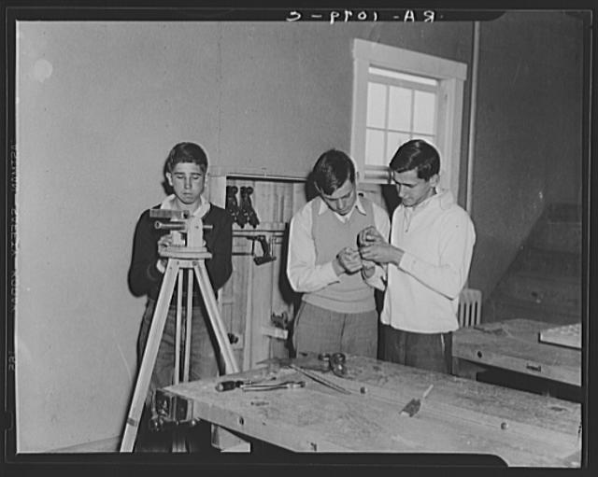
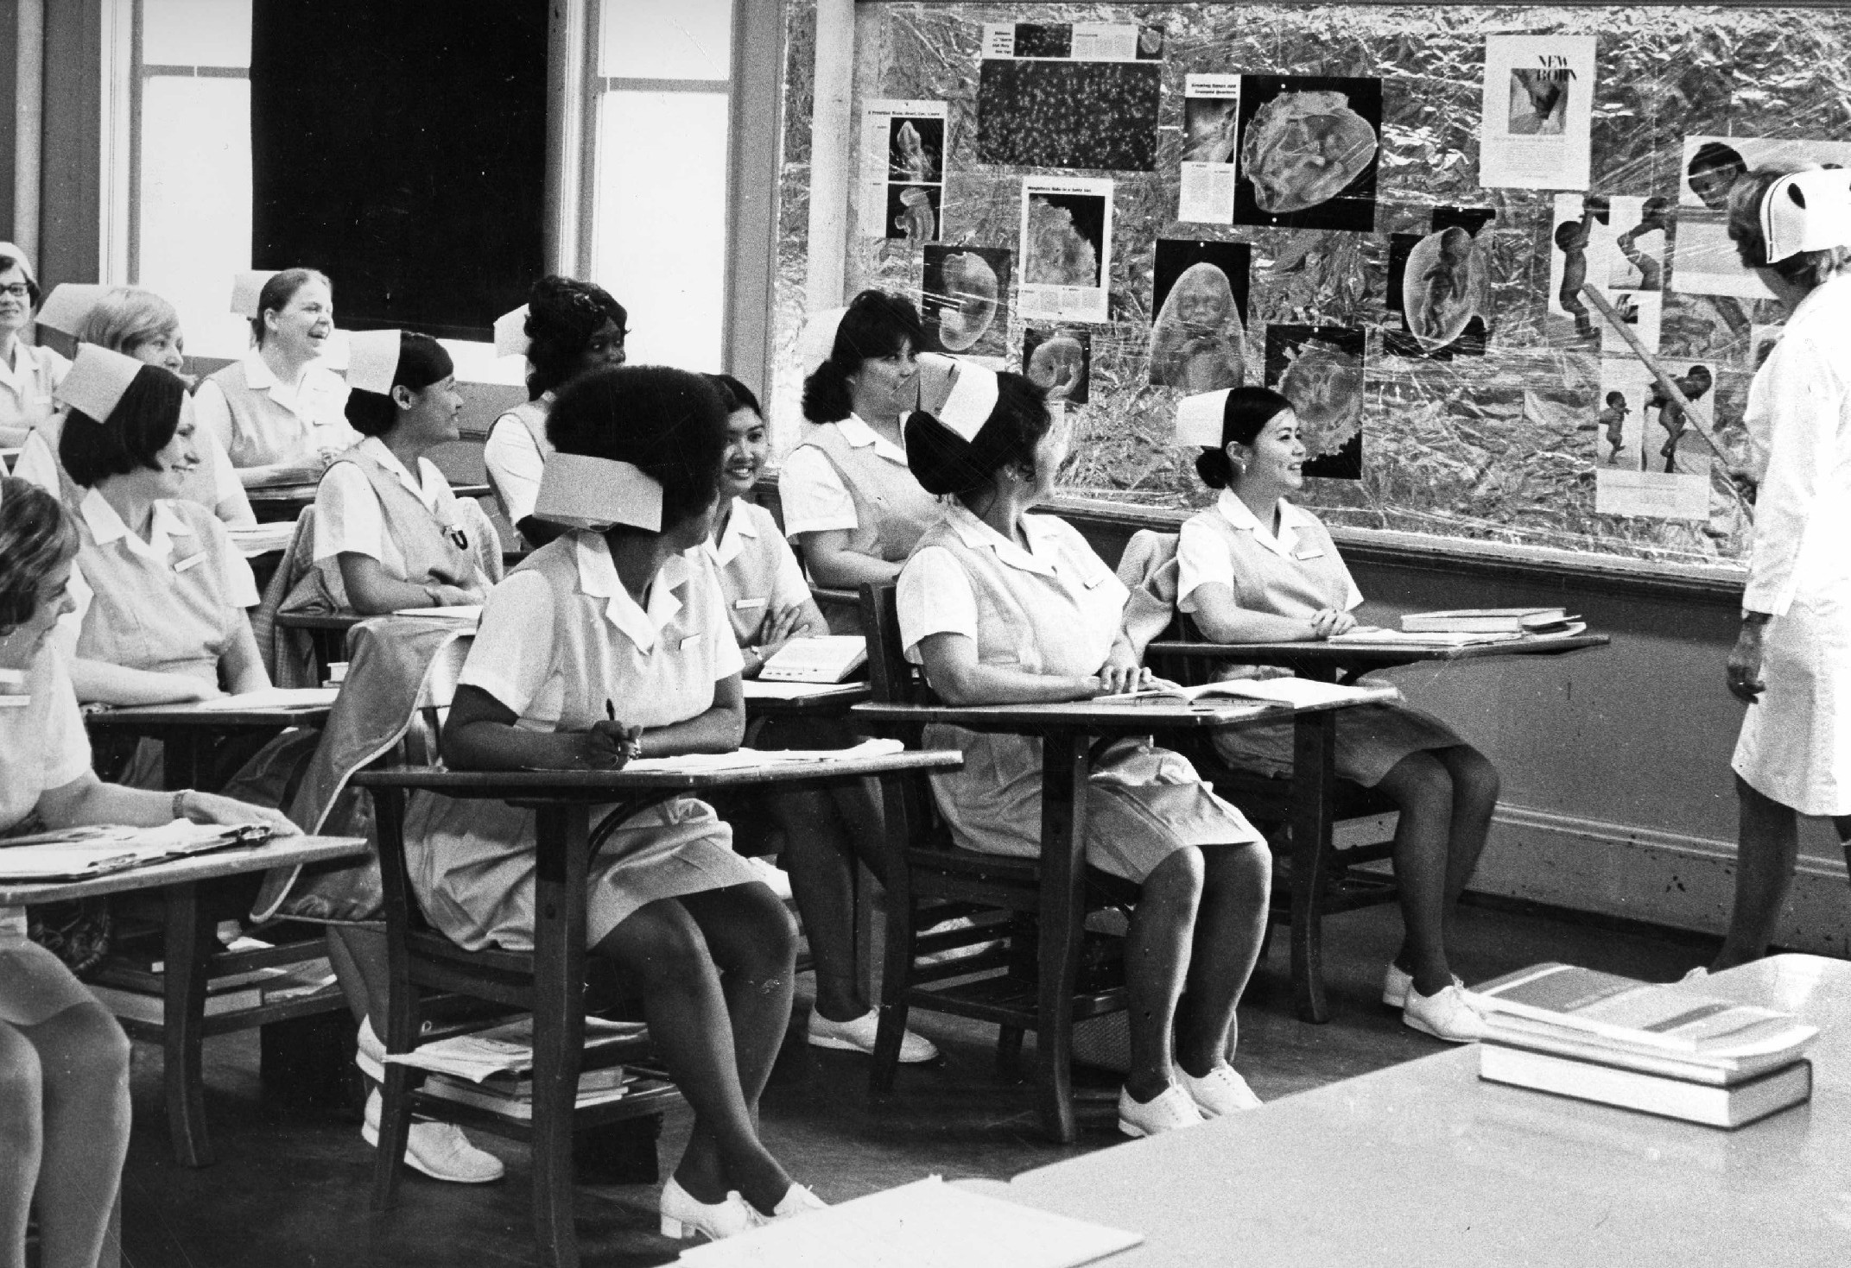
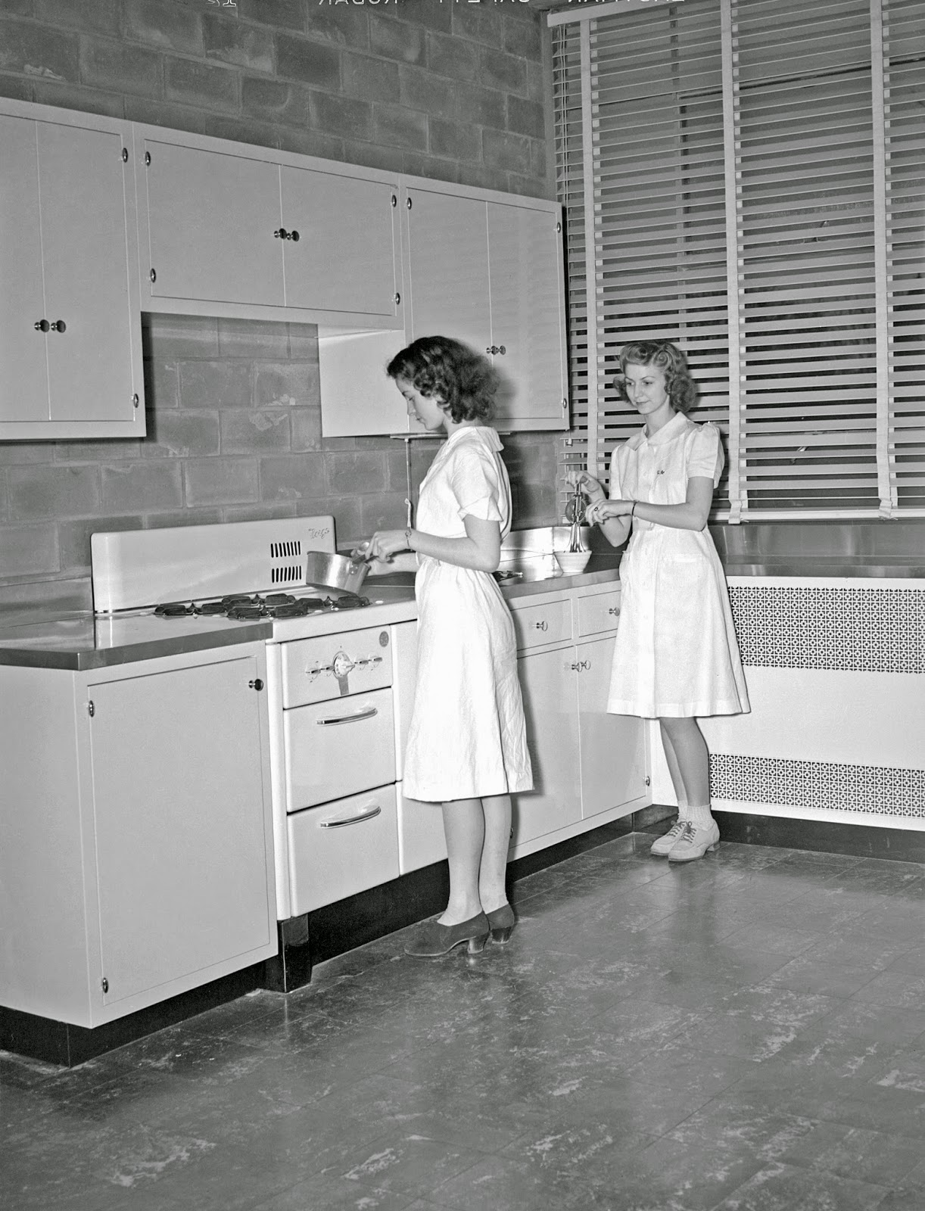
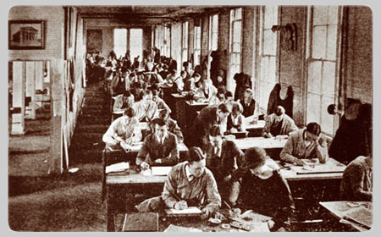
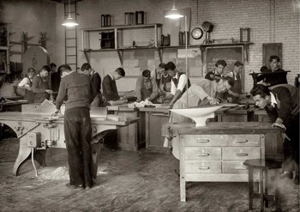

Slide 4
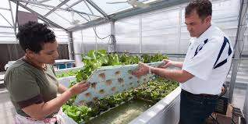
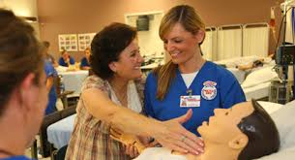
It’s YOUR
Career and Technical Education

Slide 5
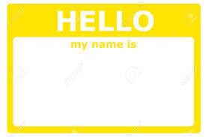
today’s cte instructors are . . .
1982 - 2002

Slide 6
The Baby Boomers
Followed the “Greatest” generation
Grew to be the activists of the 60’s and 70’s
Believe in AND PURSUE the American Dream
Influenced by: Civil rights, Vietnam war, sexual revolution, cold war, space travel

Slide 7
Generation X – parents of the millennials
Sometimes called the “lost” generation
First generation not to do as well financially as their parents
First generation of “latchkey kids”
Influenced by: Watergate, energy crisis, dual income families, Y2K, downsizing, end of cold war, increased divorce rate

Slide 8
Generation Y – the millennials
Known as the “baby bump”
The second largest generation at 75 million
Influenced by: School shootings, grew up more sheltered, the first generation of children with schedules
Child-Focused World – “Helicopter Generation”
The generation of “experiences”

Slide 9
You meet them EVERY DAY
2 screens at once
Communicate with text
Share things
Focused on present
Optimists
Want to be discovered
Life is about experiences
Life is about helping others
5 screens at once
Communicate with images
Create things
Future focused
Realists
Want to work
for success
GEN Y
GEN Z

Slide 10
How does this relate to this presentation? Or . . . Why should I stay awake for this ?
Using available technology
Creating electronic work spaces
Increase student accountability and engagement
Using internet resources to create advanced learning stations

Slide 11
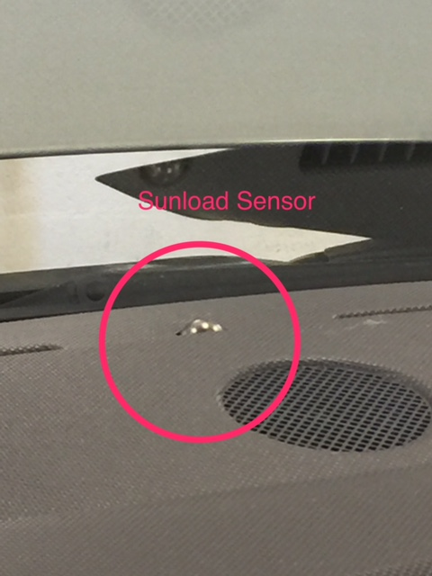
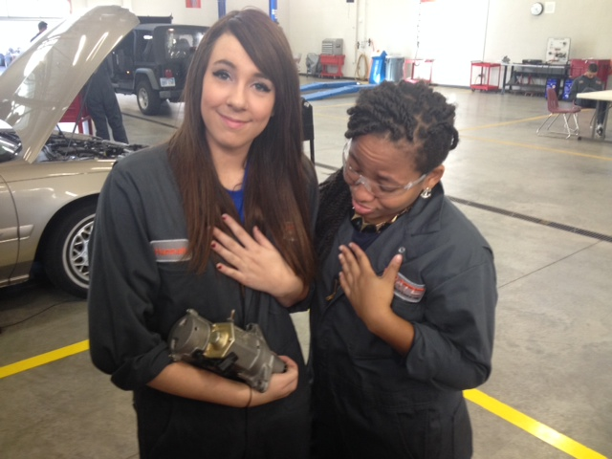
USING E-MAIL PHOTOS TO DOCUMENT COMPETENCIES

Slide 12
HAVING STUDENTS USE VIDEOS TO PROVE AND DOCUMENT UNDERSTANDING.

Slide 13
HAVING STUDENTS USE VIDEOS TO PROVE AND DOCUMENT UNDERSTANDING.
WIN AN OSCAR

Slide 15
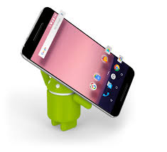
The average cell phone today has the same technology as the average laptop computer of five years ago

Slide 16
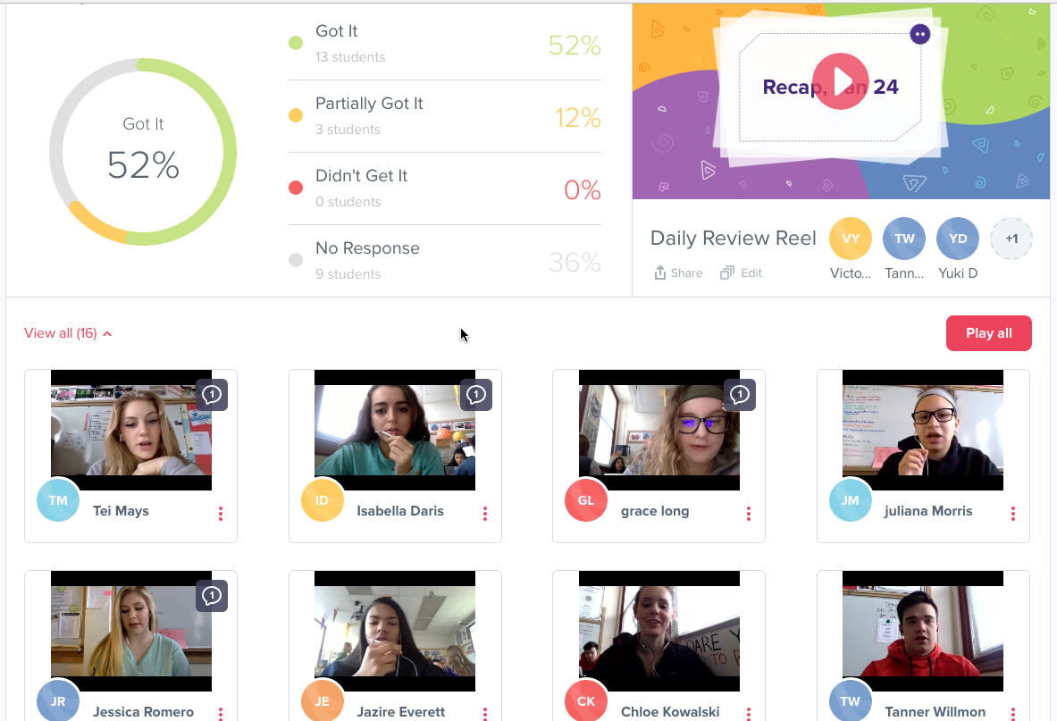
On the web . . . Recap
Formative Assessments . . . Check for understanding
https://letsrecap.com/
Interactive
Timely
Meets the needs of Gen Z learners
Increases accountability

Slide 17
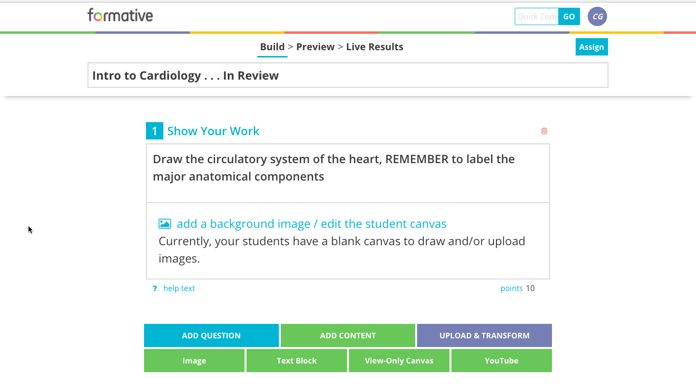
On the web . . . Goformative
Formative Assessments . . . Check for understanding
https://goformative.com/login
Interactive
Timely
Meets the needs of Gen Z learners
Increases accountability

Slide 18
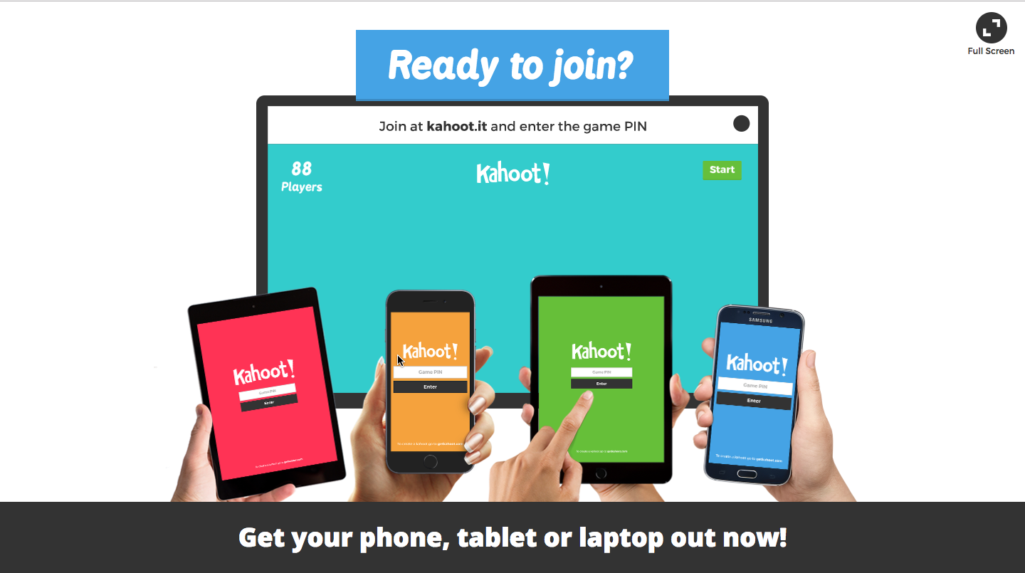
On the web . . . Kahoot
Formative Assessments . . . Check for understanding
https://kahoot.it/#/
Interactive ~ Game format
Individual or Group
Meets the needs of Gen Z learners
Increases accountability

Slide 19
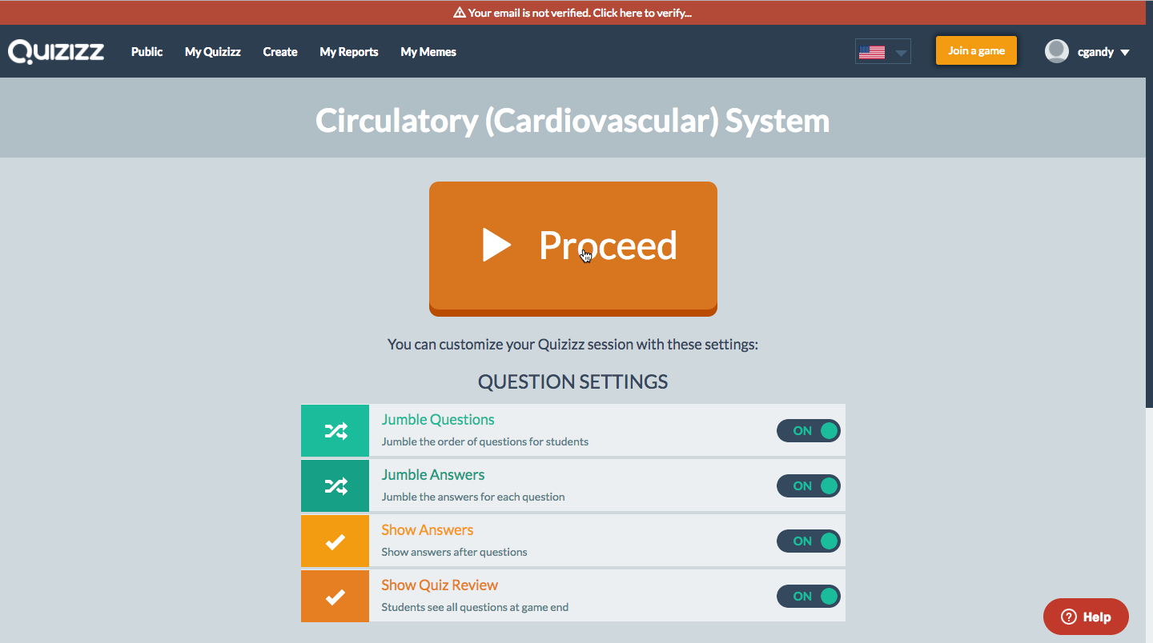
On the web . . . Quizizz
Formative Assessments . . . Check for understanding
https://quizizz.com/
Interactive ~ Game format
Individual or Group
Meets the needs of Gen Z learners
Increases accountability

Slide 20
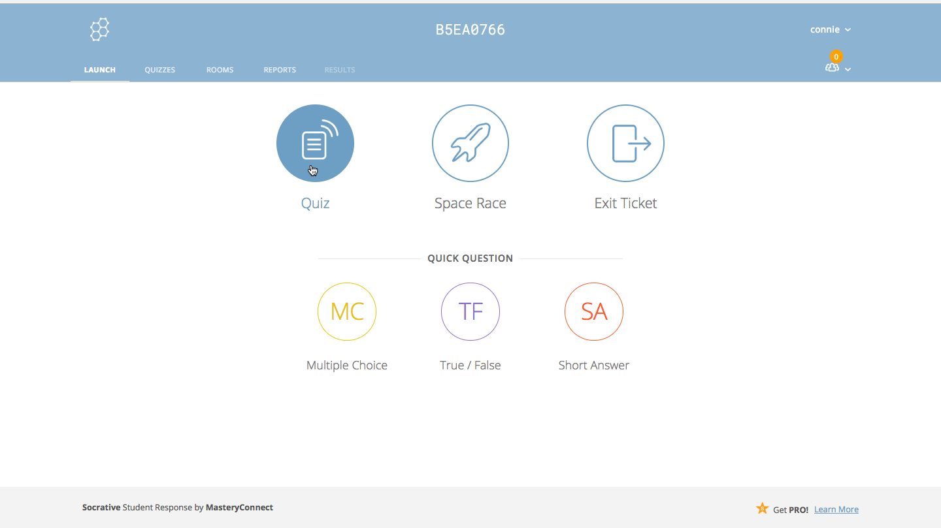
On the web . . . Socrative
Formative Assessments . . .Summative Assessments
https://www.socrative.com/
Similar to standardized online exams
Individual
Test stops when screen is interrupted
Increases accountability

Slide 21
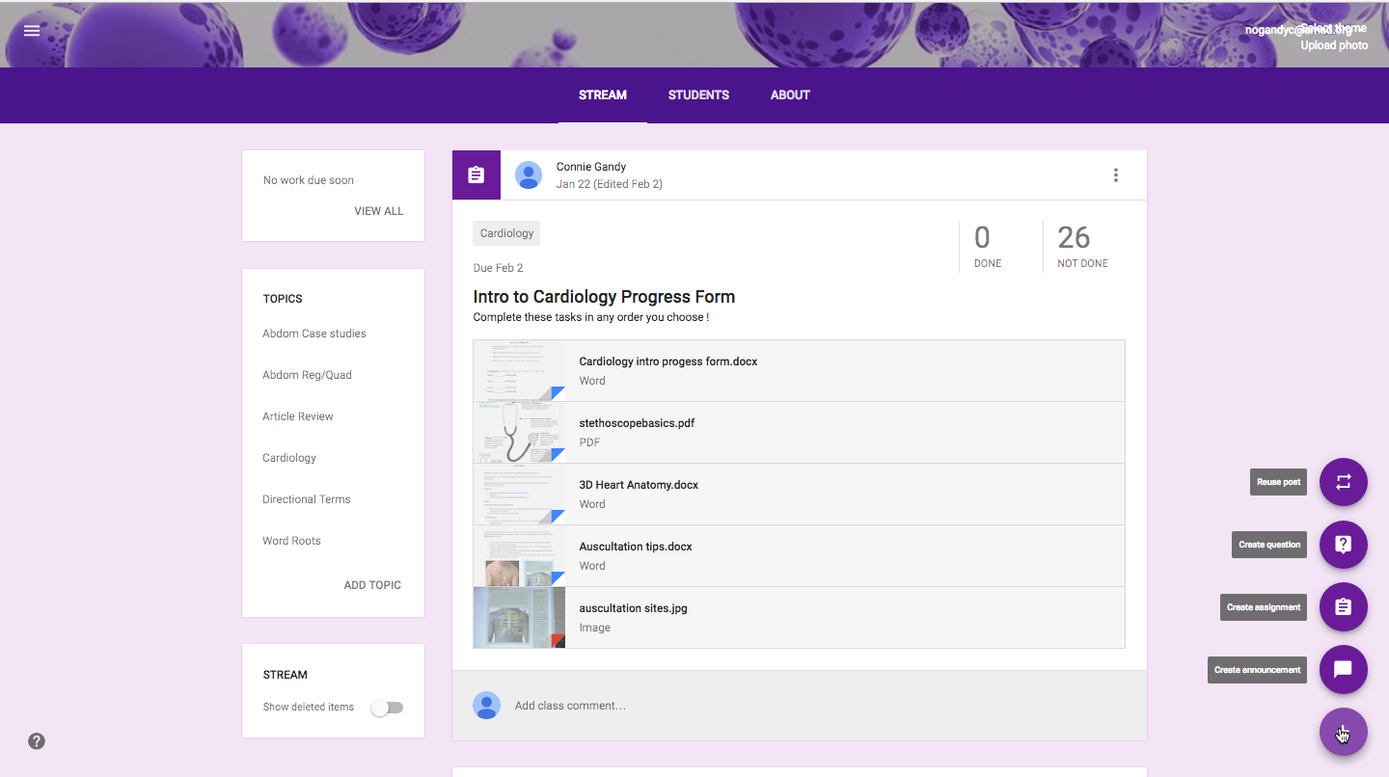
On the web . . . making your life easier
Organization . . . Continual Connection
https://classroom.google.com/u/2/c/Mzg4NjQyMjU5Nlpa
Upload documents, videos, etc., for specific tasks
Due date auto reminder
Student work can be scored and returned with comments
Can include parent/guardian

Slide 22
USING TECHNOLOGY TO IMPROVE STUDENT LEARNING and RETENTION
. . . making your job easier and more productive

Slide 23
Ken Gandy
Olathe Advanced Technical Center
kgandyoatc@olatheschools.org
Connie Gandy
Shawnee Mission School District
conniegandy@smsd.org

