Slide 1
CTE Annual Conference
Manhattan Kansas
Creating a K-12 STEM Pathway in your School Utilizing
PLTW’s
“Programs of Study”
February CTE Conference
2/8/18

Slide 2
CTE/ Session 10:30 – 11:20 AM
Presentation Team:
Andrea Holzwarth PLTW Director of School Engagement KS/MO
Marla Hayden USD 259 CTE Curriculum Specialist
Kasey Littlefield USD 259 CTE/PLTW MS Robotics
David Maneth USD 259 CTE/PLTW MS Engineering
Josh Collette USD 259 CTE/PLTW High School Teacher
Chitra Harris UDS 259 CTE/Bio-Med Teacher
PJ Reilly USD 259 CTE Curriculum Specialist

Slide 3
What Will be, Our Goals and Dreams for our Students of TOMORROW?
BY: Dr. Vince M. Bertram-----President and CEO Project Lead The Way

Slide 6
KESA---The Five “R’s”
Results
Relationships
Responsive Culture
Relevance
Rigor
“CTE is THERE with PLTW and MORE”

Slide 7
PLTW’s K-12 Programs of Study
Notes:
Now, let me tell you more about Project Lead The Way.
Through our comprehensive K-12 pathways in computer science, engineering, and biomedical science, students learn essential, in-demand skills such as:
Problem solving
Critical and creative thinking
Communication
Collaboration
Students of all grade levels are challenged in their PLTW classes and learn the importance of perseverance.
Examples of real-world activities K-12 students engage in through our computer science pathway:
Elementary: Students build digital animations based on their own short stories
Middle school: Students design mobile apps that help clients overcome obstacles
High school: Students use automation to process and analyze DNA-sequence data
This is a truly cross-disciplinary learning experience
All of these developmentally appropriate activities not only build computer science knowledge/skills, but also help students develop confidence and skills in other essential areas of study
In the examples above, students also experience:
Launch: English language arts
Gateway: professional and presentation skills
Computer Science: biomedical science

Slide 8
“Phases of LEARNING”

Slide 9
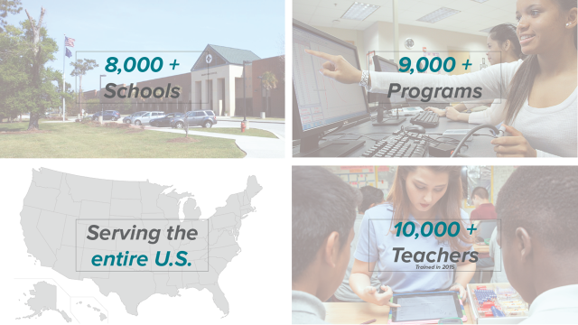
PLTW’s National Foot Print

Slide 10
PLTW Launch
A CTE Program
for GRADES K-5…
To Introduce Students to CTE/STEM Ed.

Slide 11
STEM
Learning…
Must
Start
Somewhere

Slide 12
“Strategic Planning ”

Slide 13
PLTW Launch/USD 259 Wichita
2014-2016 – Christa McAuliffe Academy K-8
Launch – Engineering Modules 1 & 2, Grades K-5
Launch – Modules 3 & 4, Grades 4 & 5
2017-18 – William Allen White Elementary School
Launch – Engineering Modules 1 & 2– Selected K-5 Elementary classrooms

Slide 14
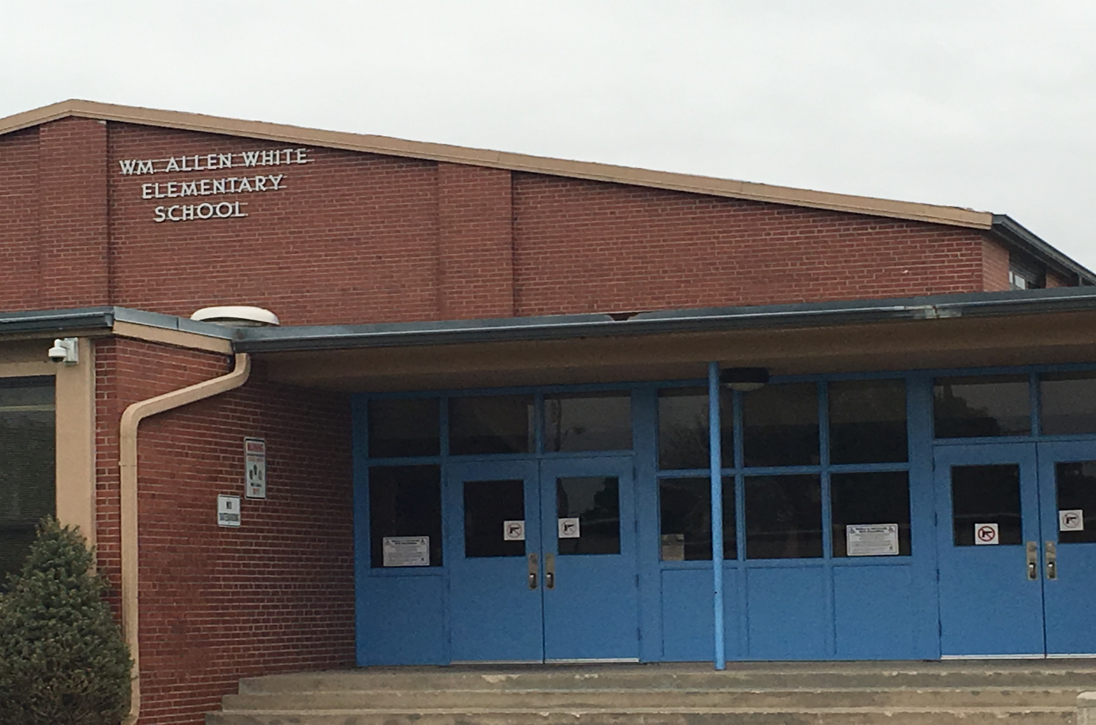

Slide 15
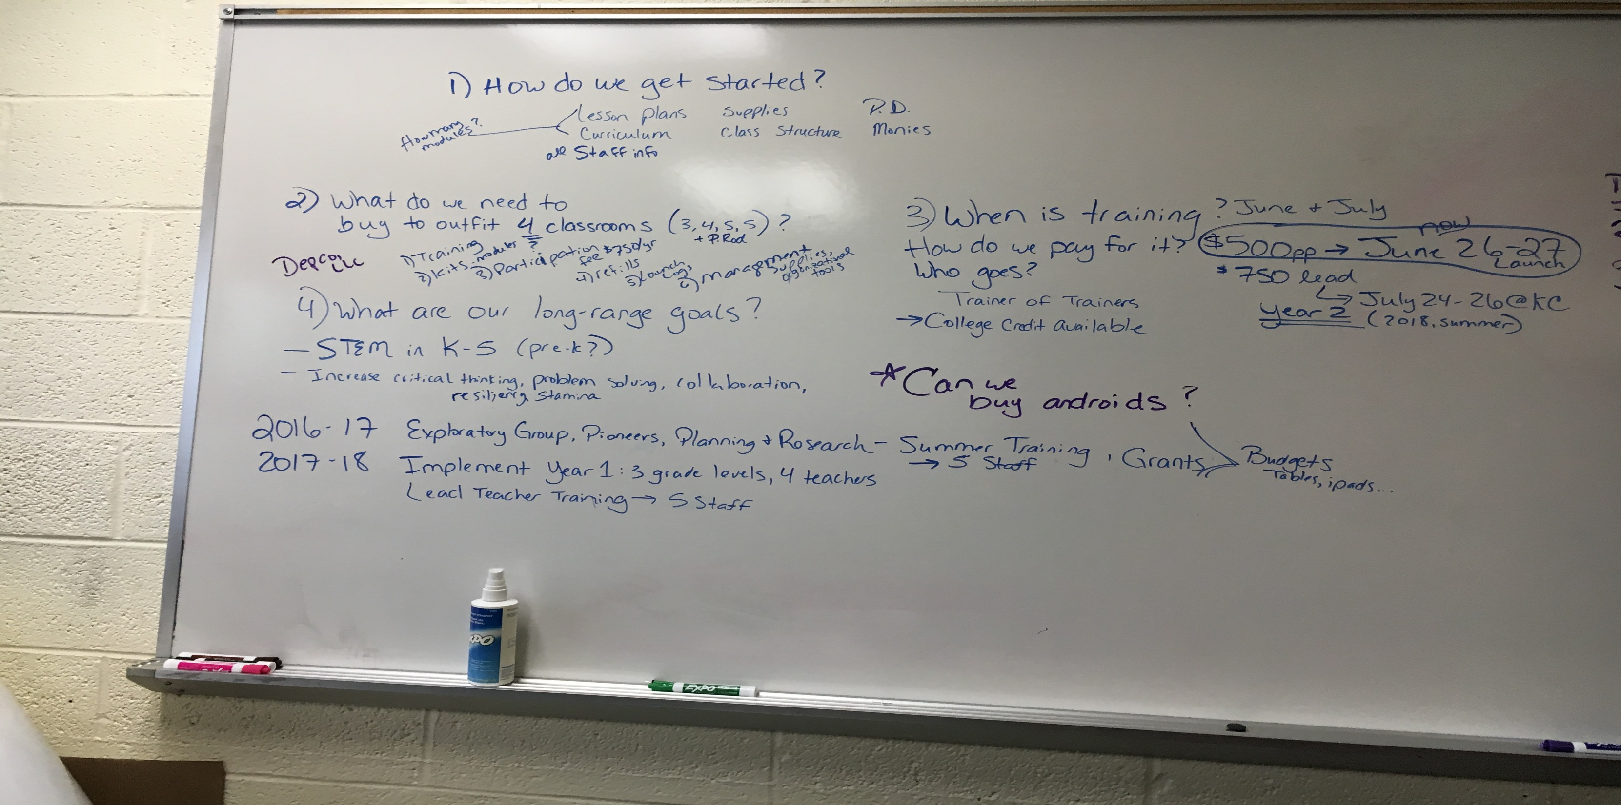

Slide 16
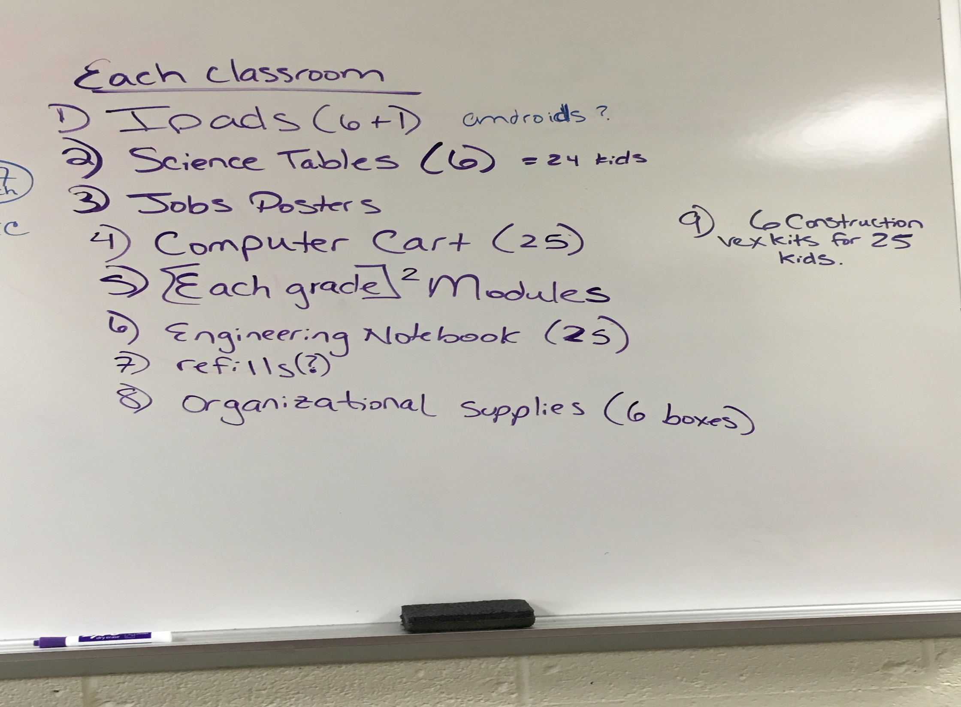

Slide 17
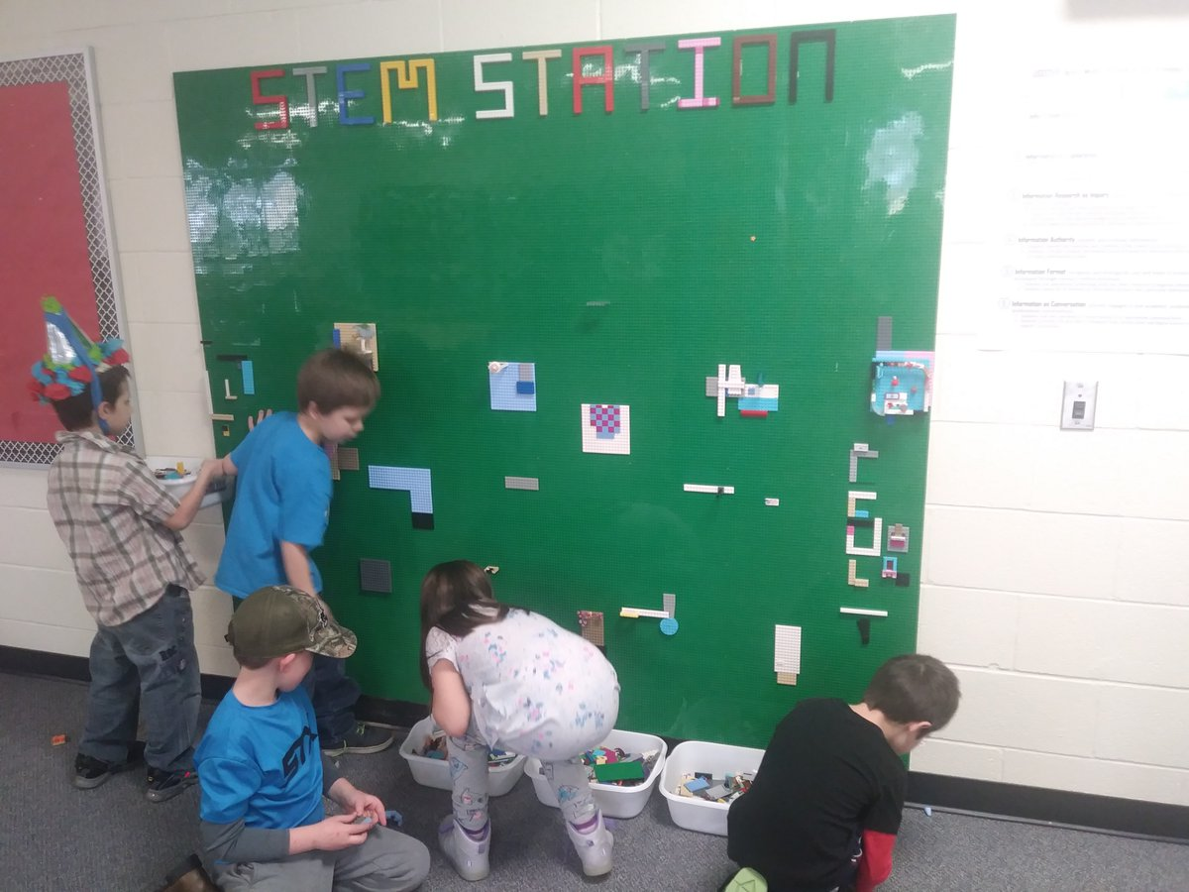
PLTW
Launch
STEM
Station

Slide 18
PLTW Gateway
A CTE Program
for GRADES 6-8…
BUILDING BLOCKS for Students in…CTE/STEM Ed.

Slide 19
Middle Level Students…Exploring Their Options

Slide 20
“Strategic Planning ”

Slide 21
PLTW GATEWAY/USD 259 Wichita
2005-2006 – Began with the high schools and middle schools Role Out
Introduction to Engineering Design (IED)
Design & Modeling/Automation and Robotics
2006-2015 – Added Middle School PLTW/GTT Courses: Medical Detectives, Green Architecture, Flight and Space, Energy & Environment, Magic of Electrons, Science and Technology

Slide 22
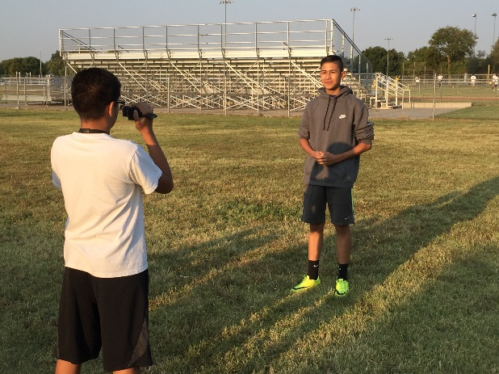
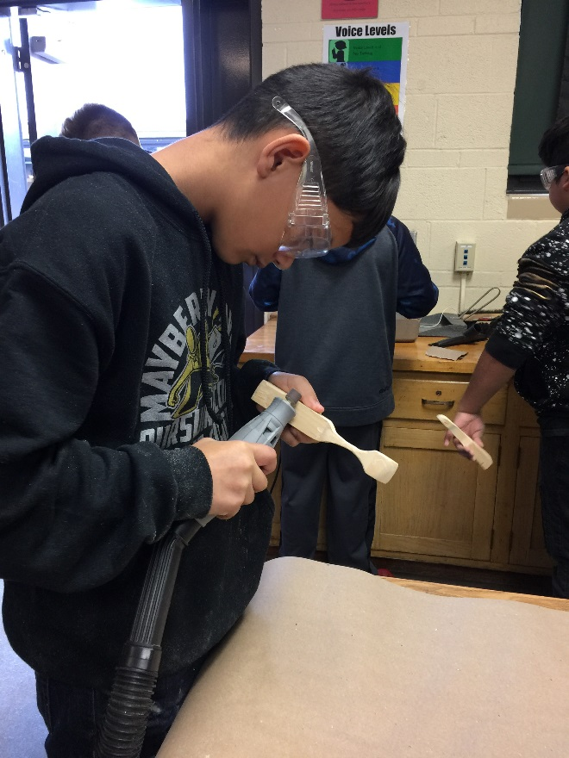
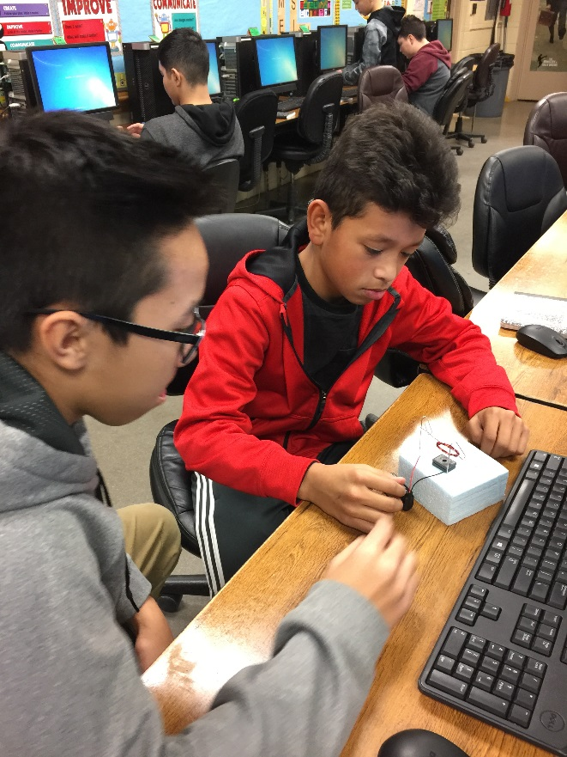
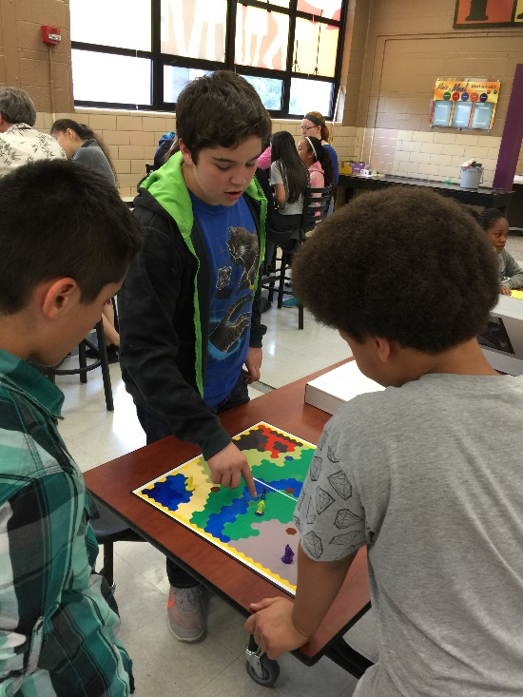
PLTW Middle School
Gateway

Slide 23
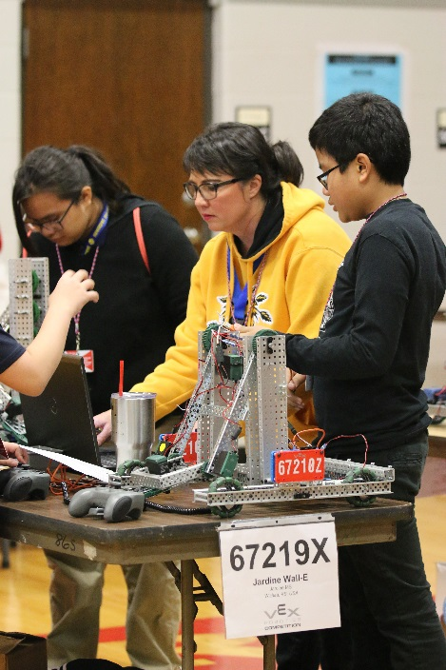
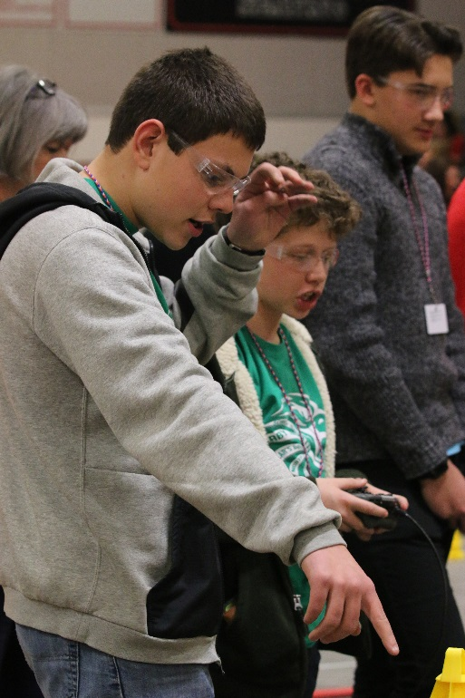
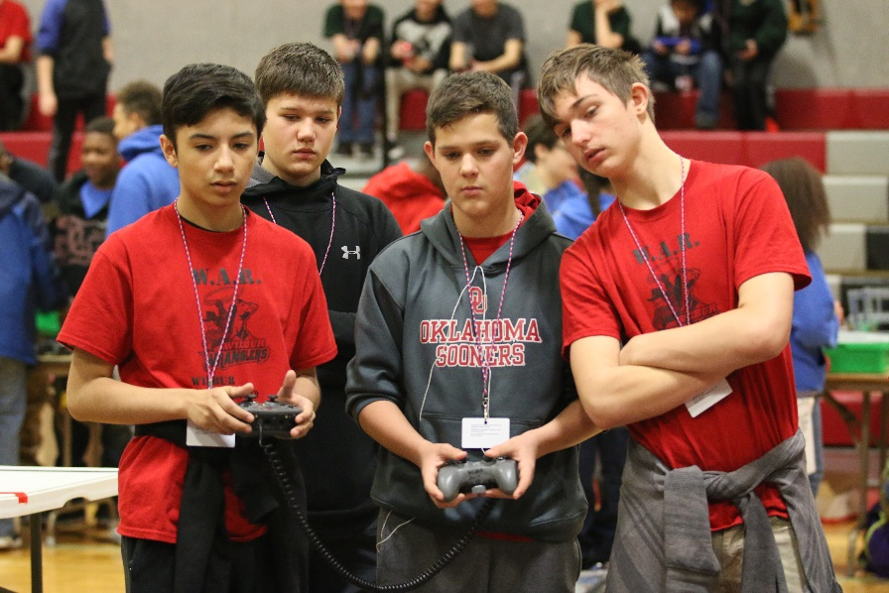
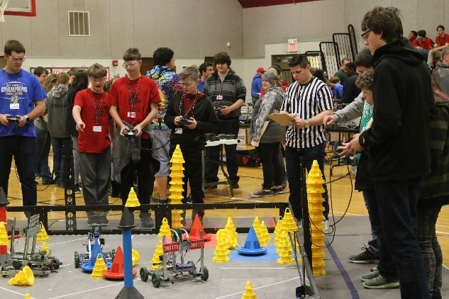
PLTW Middle School
VEX Robotics

Slide 24
PLTW High School
A CTE Program
for GRADES 9-12…
EXPANDING Students Interest in… CTE/STEM Ed.

Slide 25
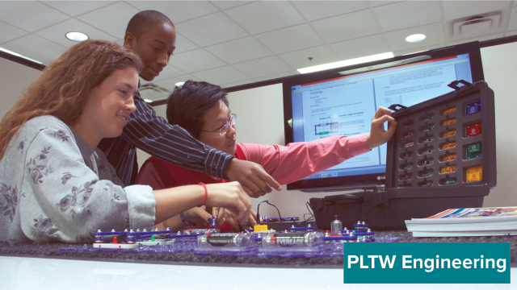
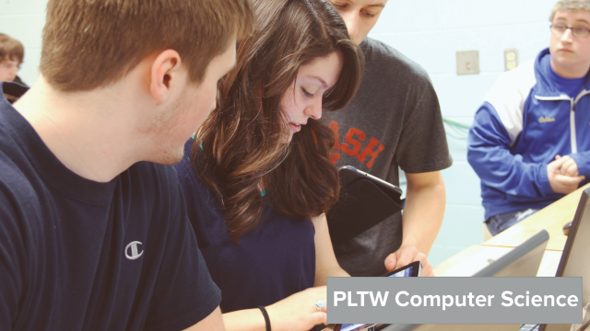
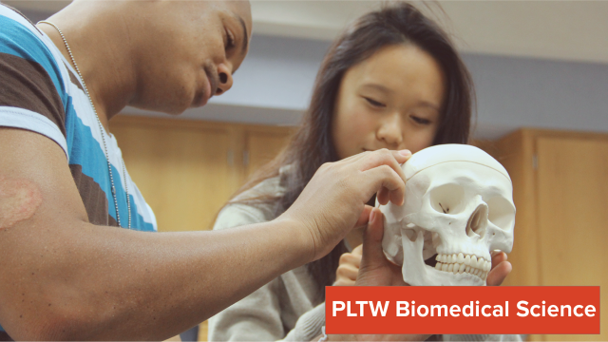
High School PLTW
OPTIONS
For
STUDENTS

Slide 26
“Strategic Planning ”

Slide 27
BIO-Medical/USD 259 Wichita
2014-2017– High School
Biology/Honor Bio
Principles of Biomedical Sciences*
Human Body Systems (HBS)*
Medical Inventions*
CNA/CMA/HHA
Biomedical Innovations
Forensics
* Denotes PLTW Course

Slide 28
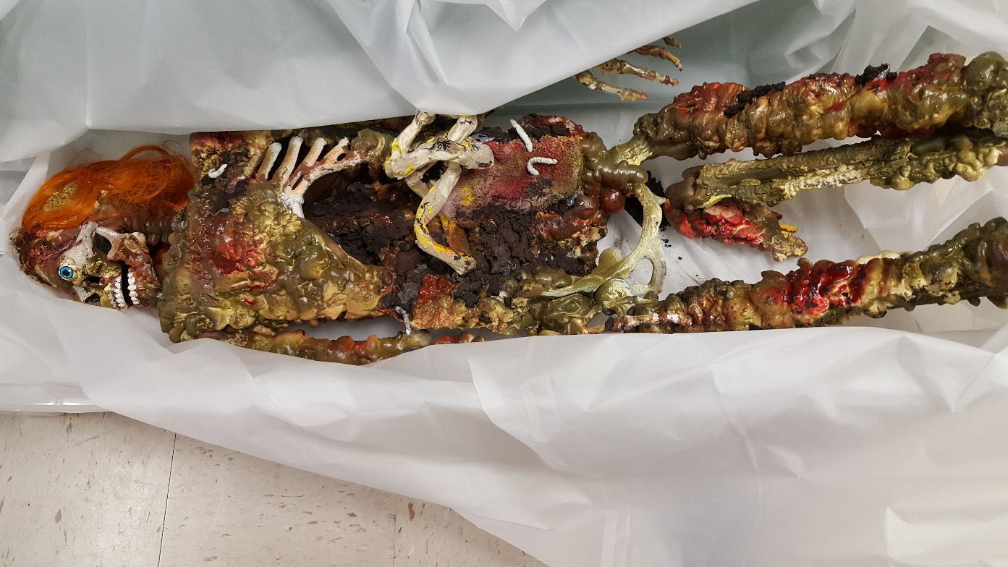
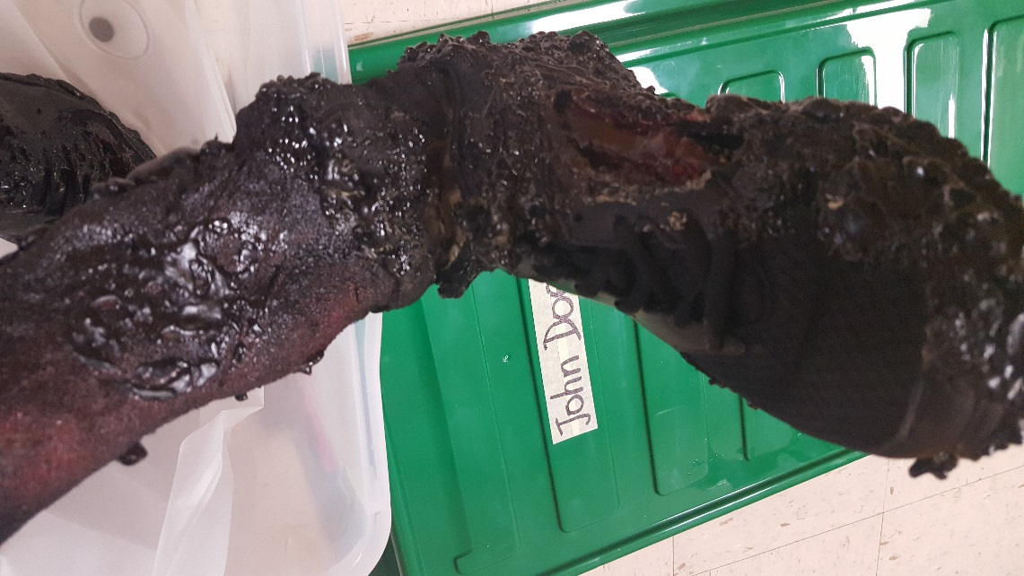
High School Biomedical -
Cross Walking into Forensic Science

Slide 29
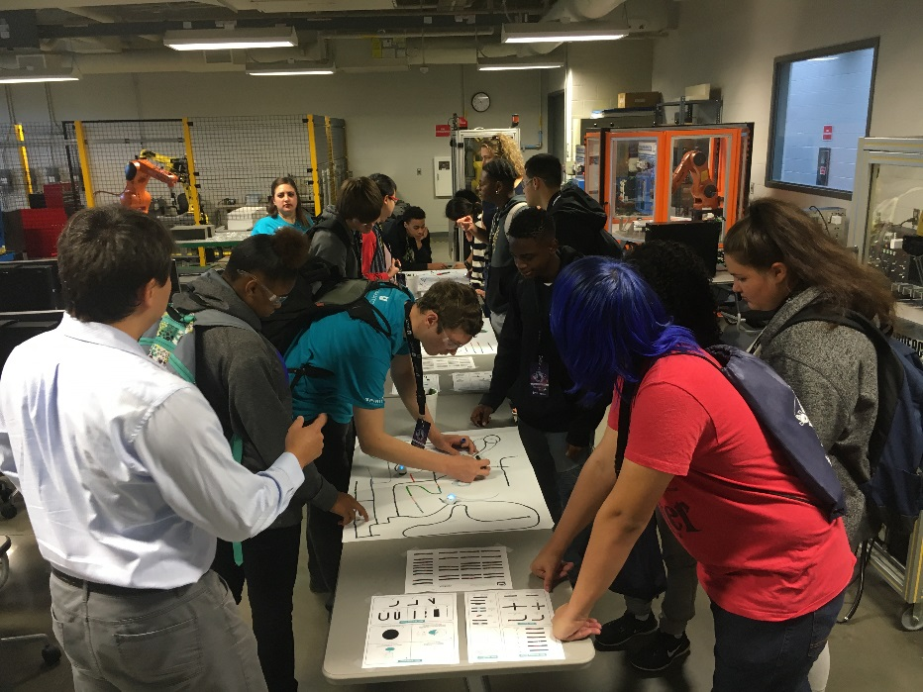
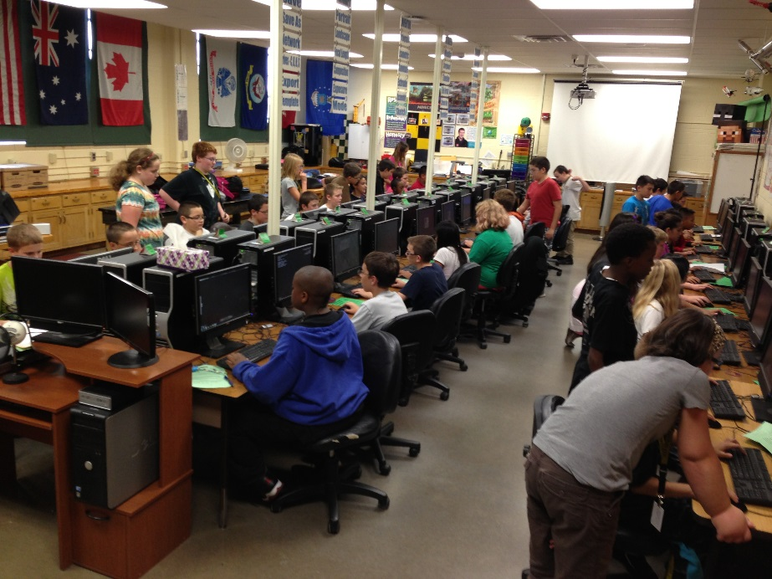
Computer Science/USD 259 Wichita
2017-2018 – Added…
Introduction to Computer Science (ICS/CSE) – NEM & East HS
Computer Science Principles (CSP) – East HS

Slide 30
Engineering/USD 259 Wichita
2006-2017 – High School
Introduction to Engineering Design (IED)
Principles of Engineering (POE)
Civil Engineering and Architecture (CEA)
Digital Electronics (DE)
Aerospace Engineering (AE)
Computer Integrated Manufacturing (CIM)
Engineering Design and Development (EDD)

Slide 31
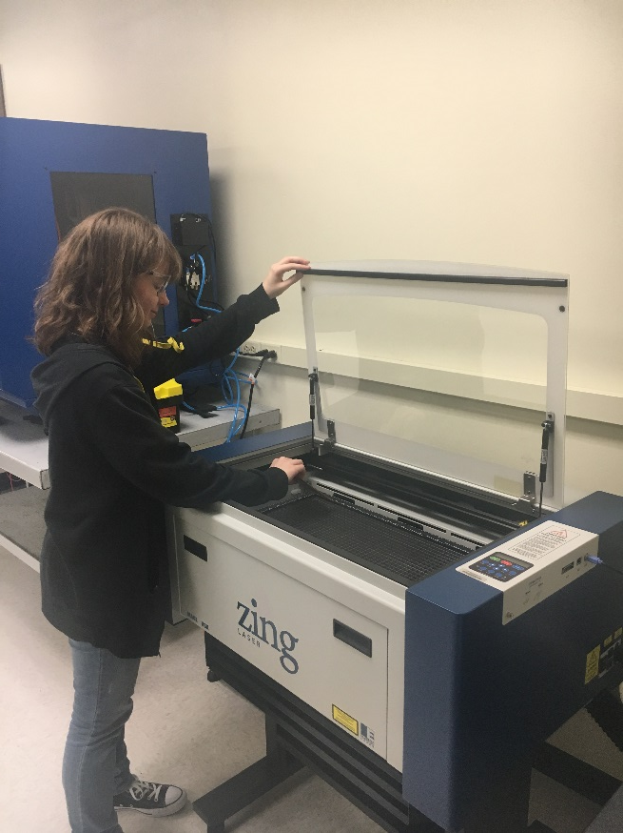
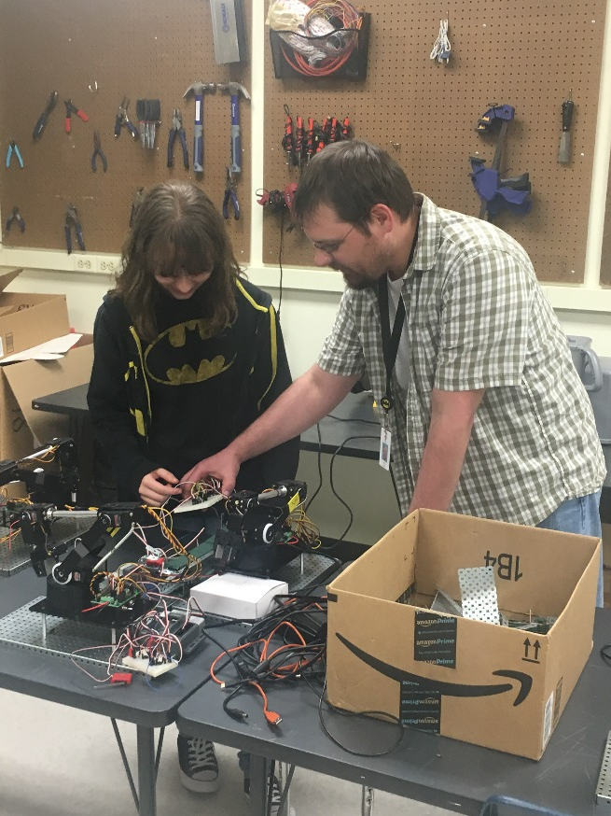
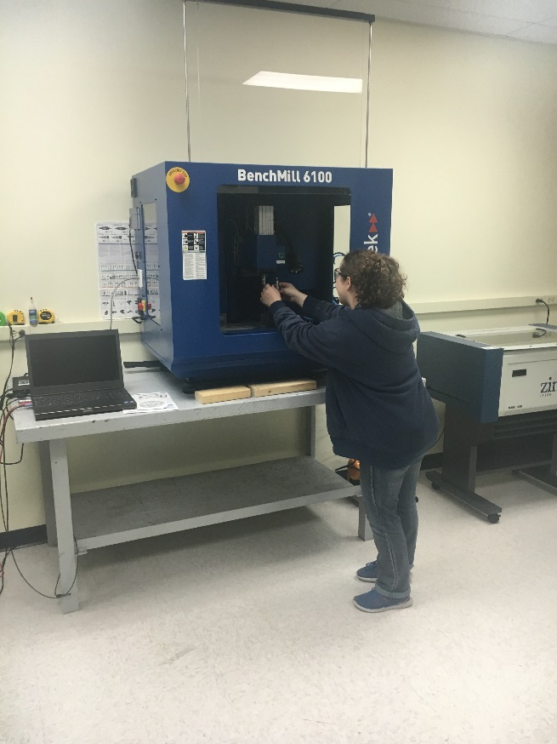
PLTW High School Engineering -
Computer Integrated Manufacturing (CIM)

Slide 32
“Application of SKILLS”

Slide 33
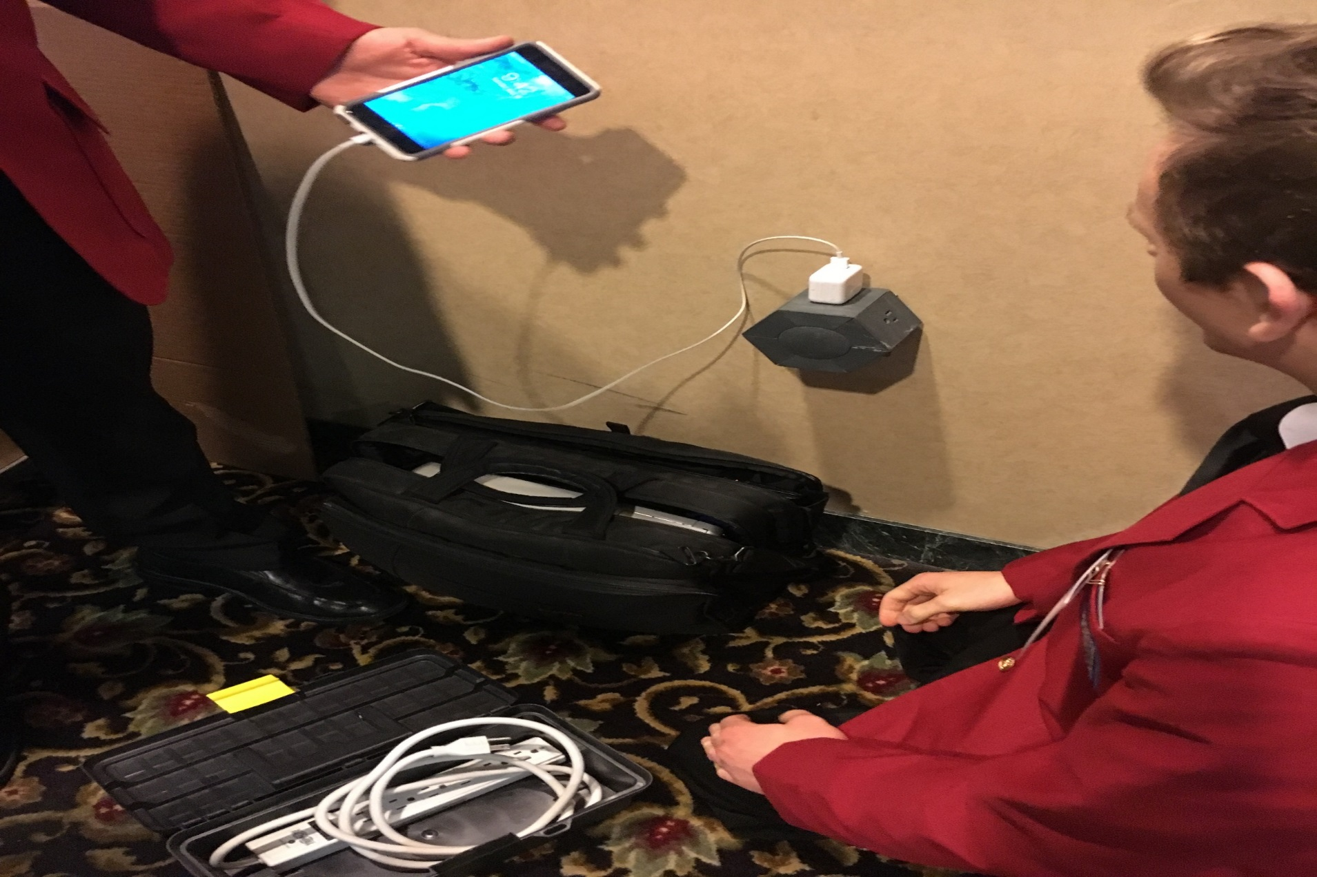
Engineering
Design
And
Development
(EDD)
SkillsUSA
State Championships
Contest:
Engineering Design
And Technology

Slide 34
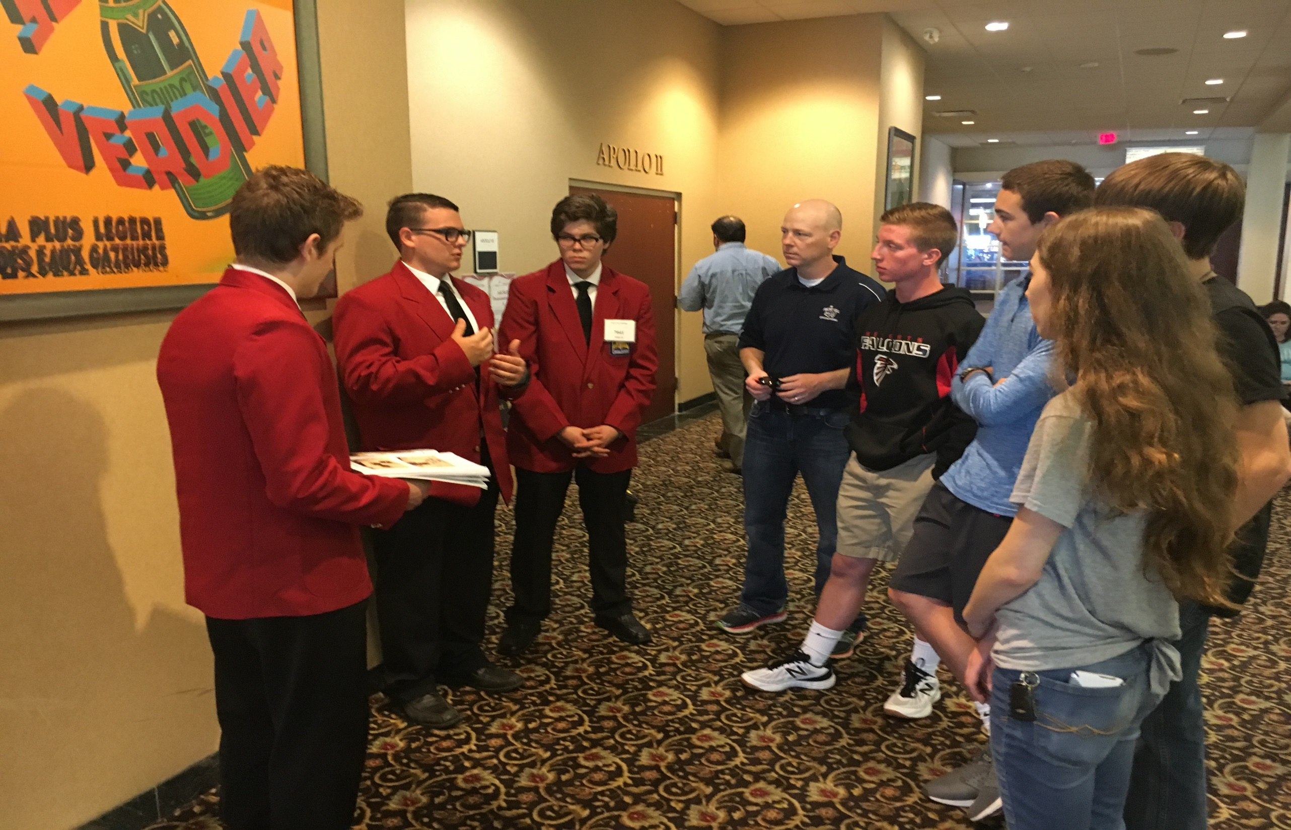

Slide 35
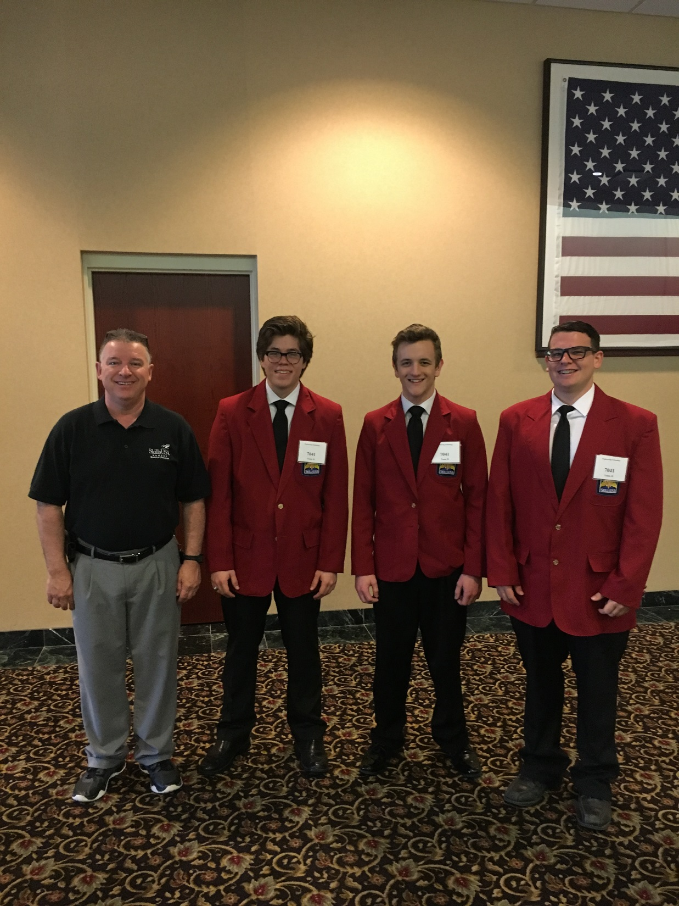
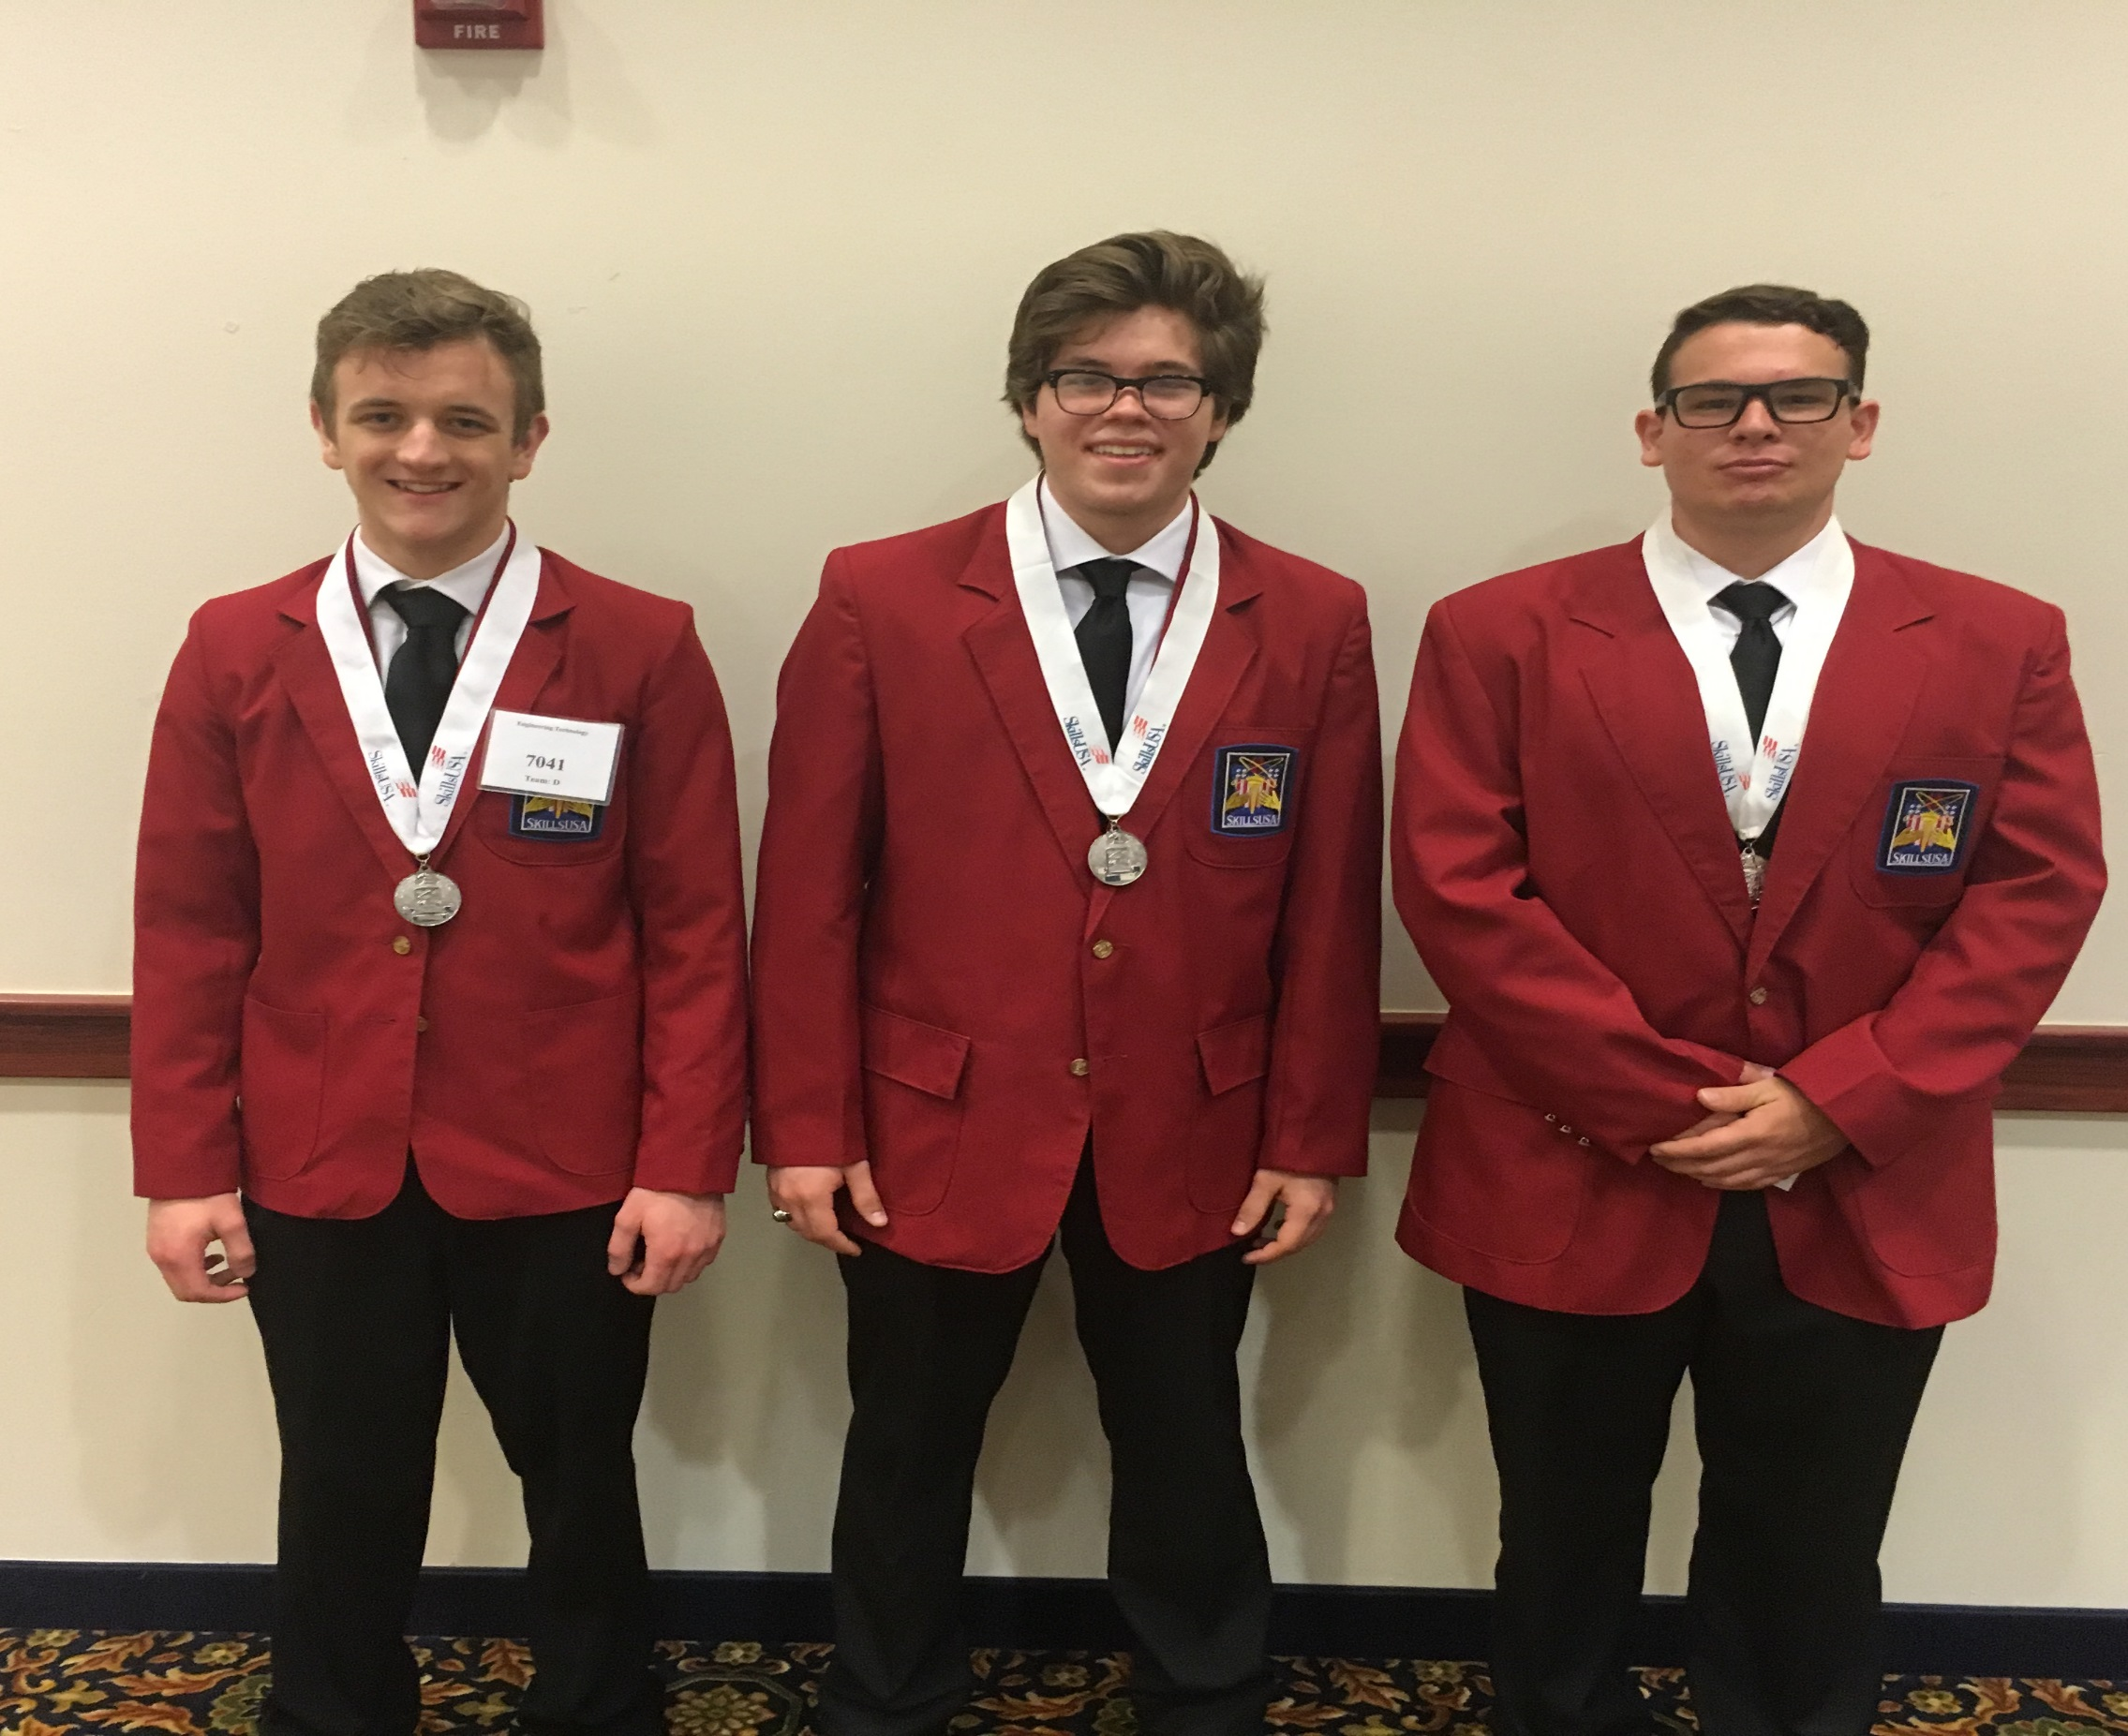

Slide 36
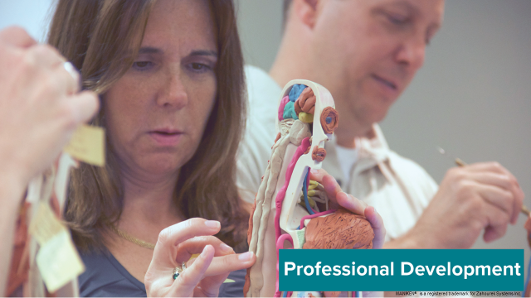
Preparing and Training Staff ...

Slide 38
Questions or Need Additional Information-Contact
Andrea Holzwarth
Director of School Engagement/Project Lead the Way/KS-MO
785-332-0293, aholzwarth@pltw.org
Marla Hayden and PJ Reilly
WPS/USD 259 Curriculum Specialist/Career & Technical Education
316-973-4511 CTE Office
mhayden@usd259.net
preilly@usd259.net

