Slide 1
Herington high school CTSO presentation
How to make CTSO’s work in a small school

Slide 2
Presentation Outline
Presenters Introductions
Background – Lisa Beye
Retreat and Philanthropic Events – Kim Coover
Competitions – Mark Hager
Fundraising – Megan Mein
Road Blocks – Brandi Hendrix
Questions

Slide 3
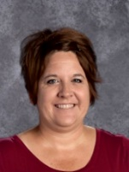
Lisa BEye
EDUCATION:
BA from Bethany College
MS from Emporia State EXPERIENCE:
23 years in Education
Lenora High School
Council Grove High School
Centre High School
Herington High School
PATHWAY’S
Business, Management and Administration
Finance
Marketing
Business Teacher
FBLA Advisor

Slide 4
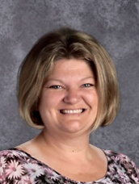
Kim coover
EDUCATION:
BS from Kansas State University
MS from Emporia State University EXPERIENCE:
19 years in Education
Herington High School
PATHWAY’S
Health
Biomedical
science Teacher
hosa Advisor

Slide 5
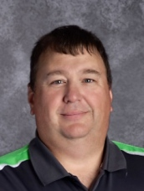
Mark hager
EDUCATION:
BS from OPSU
Working on MS from Pitt State EXPERIENCE:
13 years in Education
Oklahoma Schools
Centre High School
Herington High School
PATHWAY’S
Comprehensive Agriculture Science
Power, Structural & Technical Systems
Ag Education Teacher
FFA Advisor

Slide 6
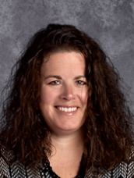
Megan mein
EDUCATION:
MS from Kansas State University EXPERIENCE:
11 years in Education
Herington High School
PATHWAY’S
Teaching and Training
Early Childhood Development
Human Services
Culinary-Hospitality Management
Facs teacher
fccla advisor

Slide 7
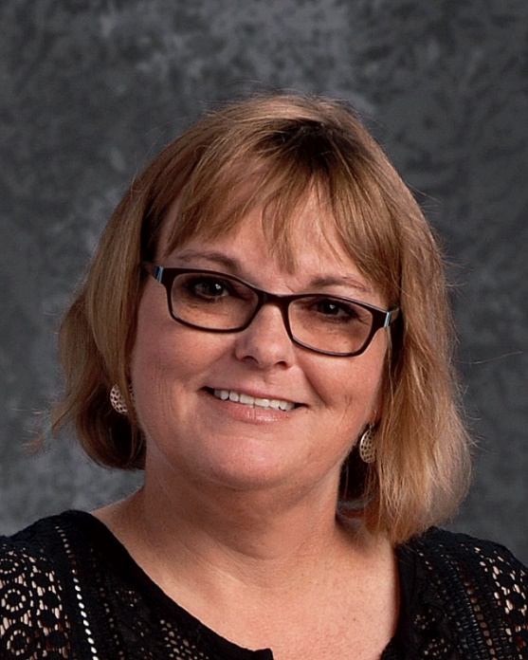
Brandi hendrix
EDUCATION:
BA from Wichita State University
MS from Wichita State University
Building Leadership from Baker University EXPERIENCE:
15 years in Education
6-12 Principal

Slide 8
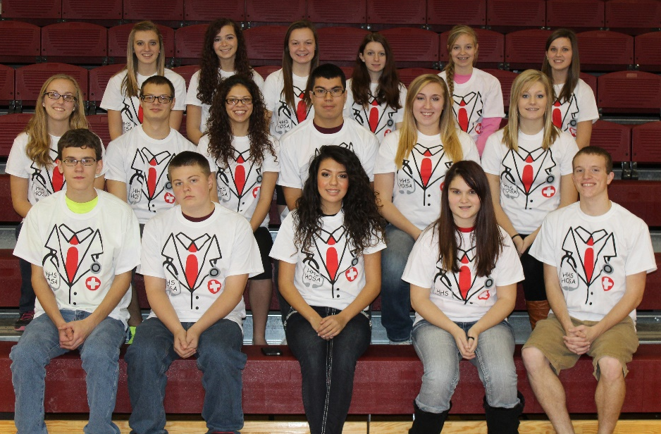
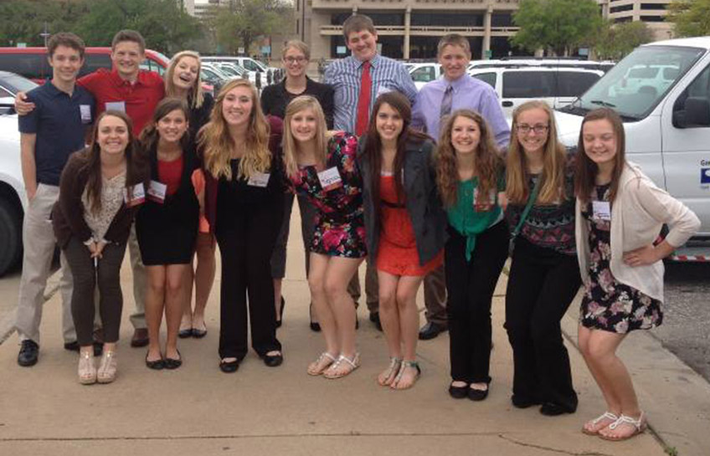
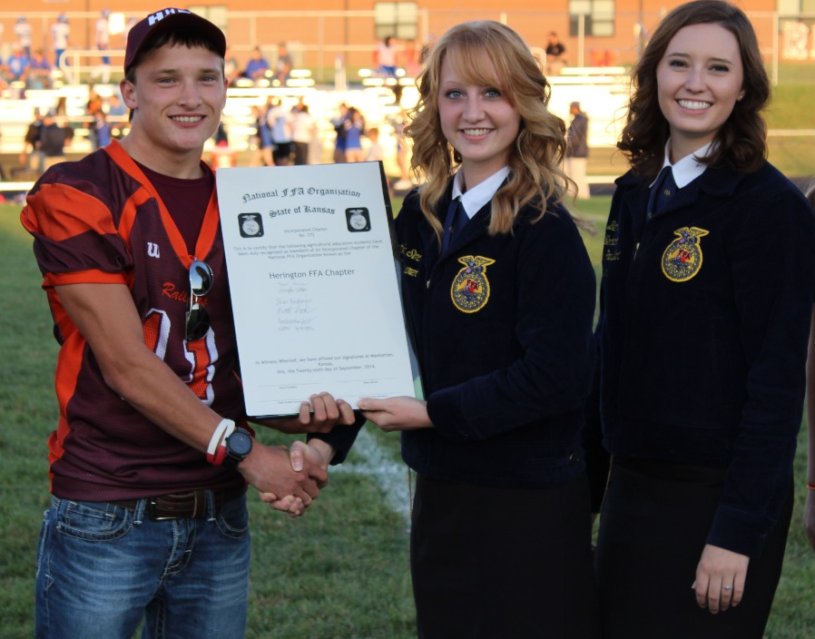
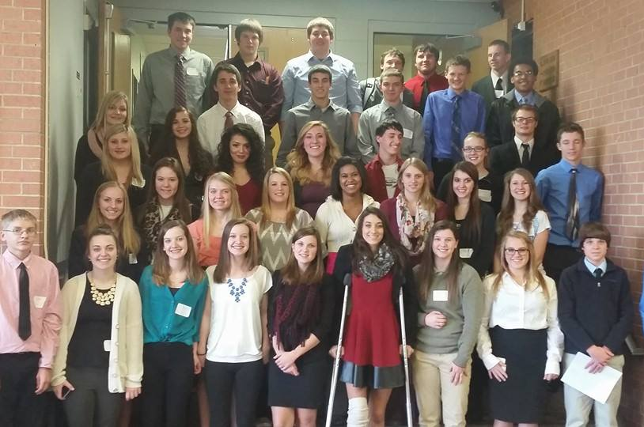
Background…. How it all began at Herington High School
HOSA
FCCLA
FFA
FBLA
Notes:
Prior to teaching at Herington High School, Mr. Hager and I both worked at Centre together for a couple years before coming over to Herington. During this time the only two organizations at Centre were FBLA and FFA. Centre had established a very good working relationship between the organizations. So when Mark and I both came to Herington it was easy to continue that relationship. During the 2014 school year Herington added FFA, FBLA and HOSA to go along with its already established FCCLA. That was a big shock to the students and community in the first year. Three new groups, three new fundraising, three new competitions, more time out of school, more money…..what do we do. In the spring the four of us did some brainstorming on what we could do to not make these groups so over whelming. We were getting slack from core teachers for students being gone to lots of competitions, we were getting slack from the community with being hit hard with fundraising, were were demanding more and more out of kids. We did not want this to backfire in our faces.
So we came up with a solution. How can the four CTSO’s work together to be the most effective in our school. How could we share resources, fundraising and activites to better the students of our community. And that is

Slide 9
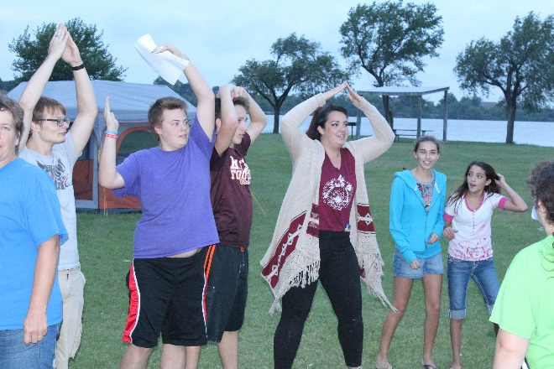
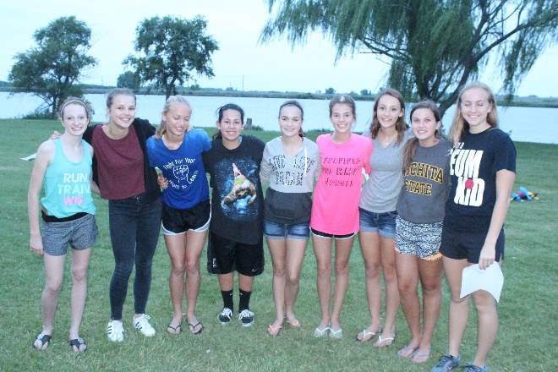
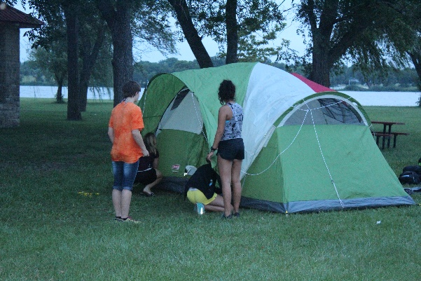
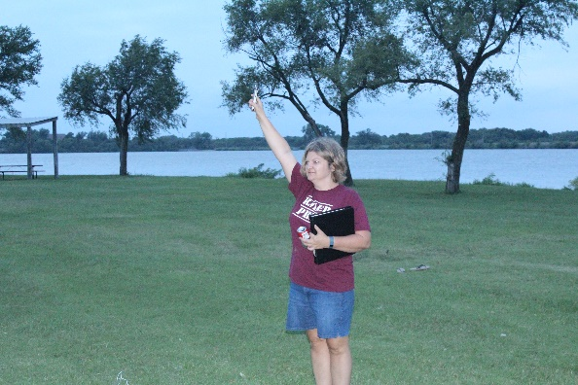
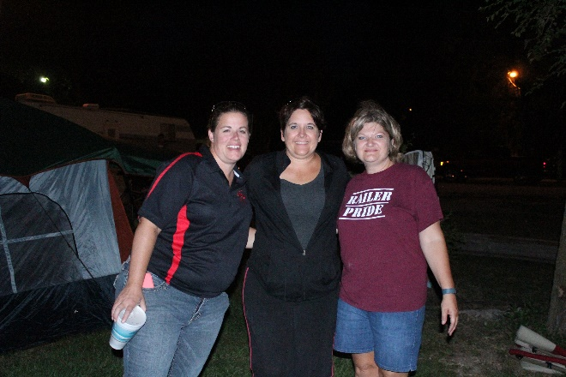
Fall Retreat
Friday or Saturday of first week
Officers help plan event
Campfire activity and 1 game per group
Benefits:
Great CTSO icebreaker
Introduce Freshmen and new students to other students
Drawbacks:
Sponsors are too old to stay up all night

Slide 10
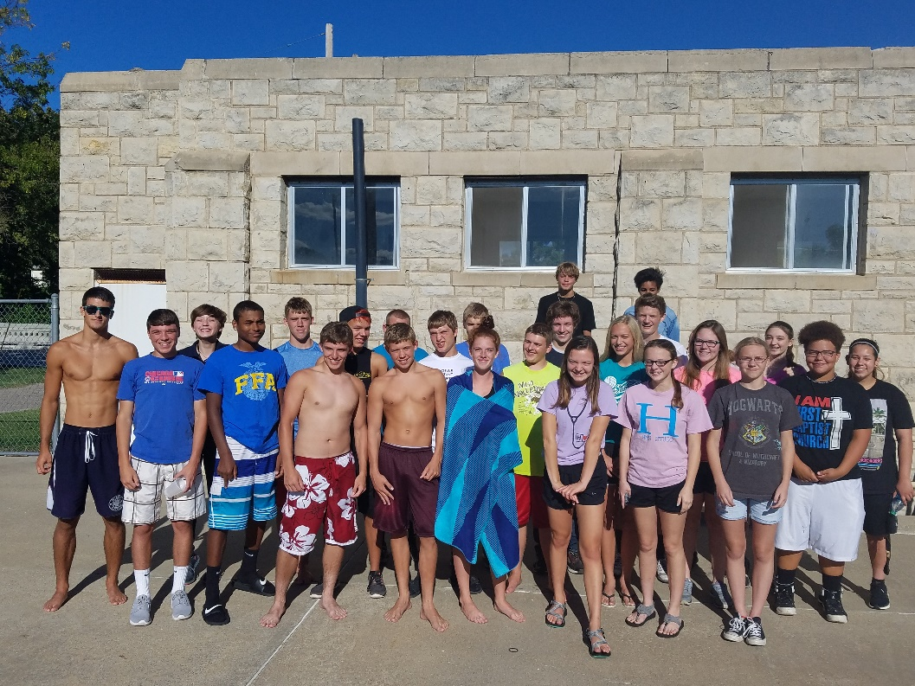
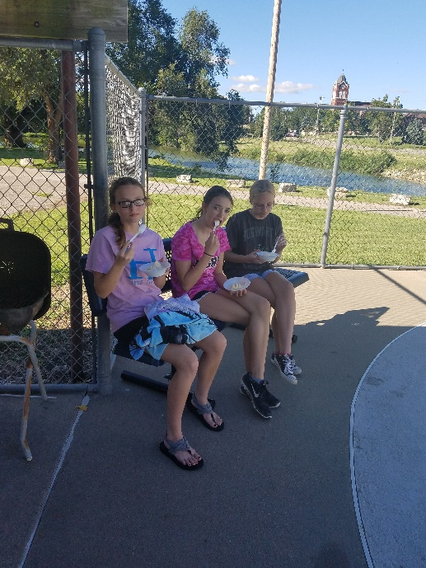
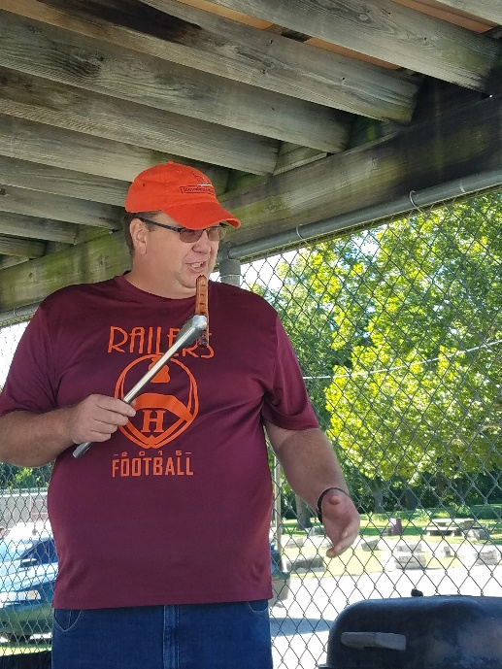
Retreat Year 2
Pool Party
Picnic and pool time
Benefits:
Much less time intensive to plan
Lower risk of problems
Drawbacks:
Not as adventurous
Maybe not as much bonding since time was much shorter

Slide 11
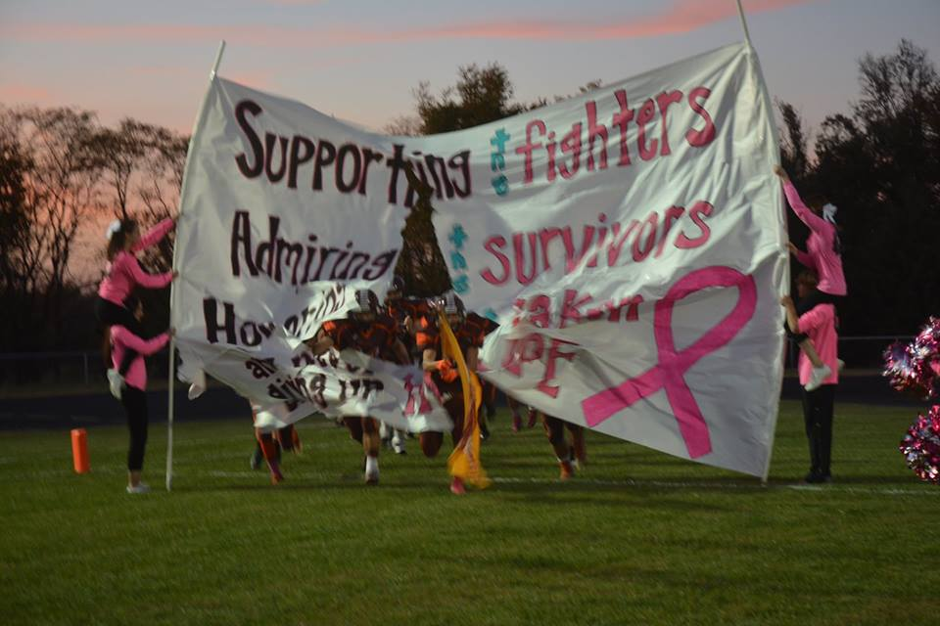
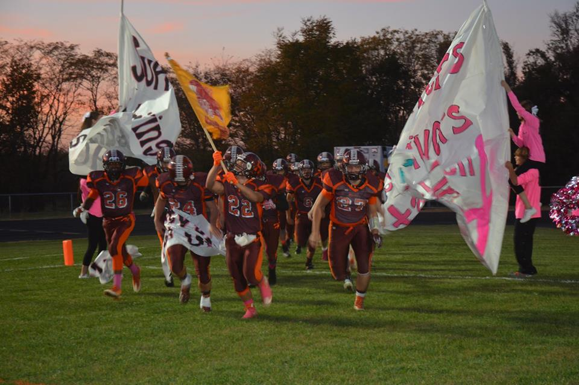
Pink Out
CTSO’s planned pink out together
Morning meetings
Passed a boot in the stands
Homeroom poster competition
Winning homeroom got a pizza party
Sold luminaries
T-shirts designed by Engineering Ink and sold for event
Donated money to Elsie Brooks foundation which is a local organization to help cancer patients with transportation and supplies

Slide 12
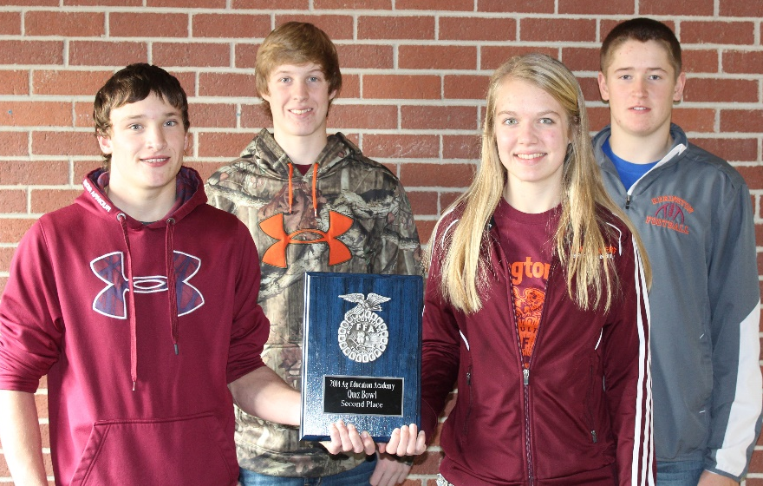
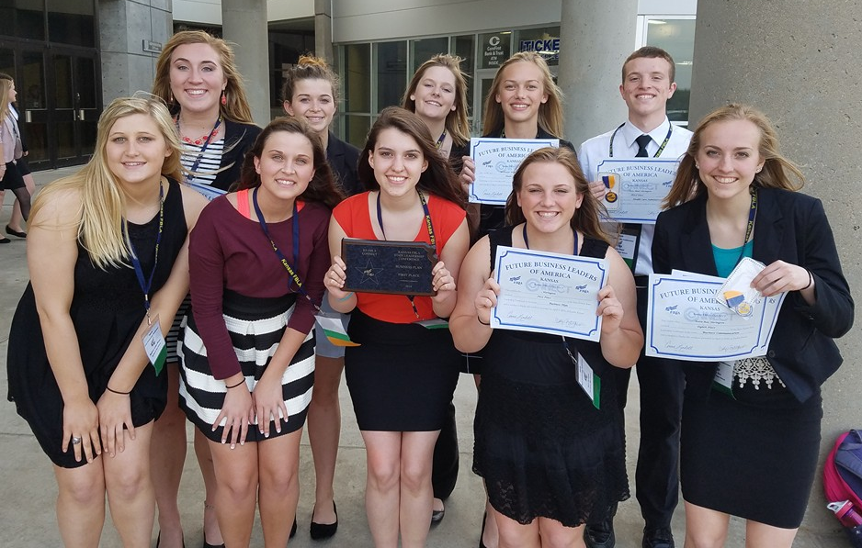
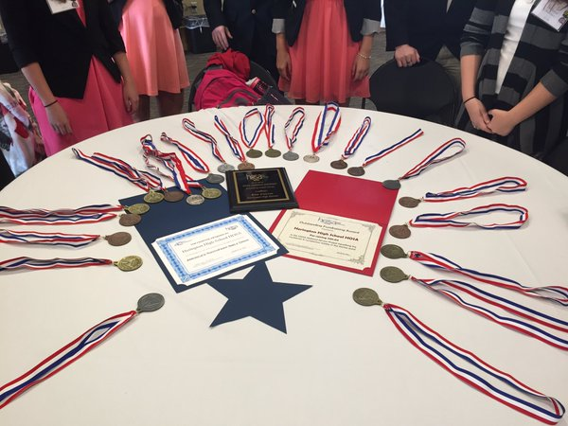
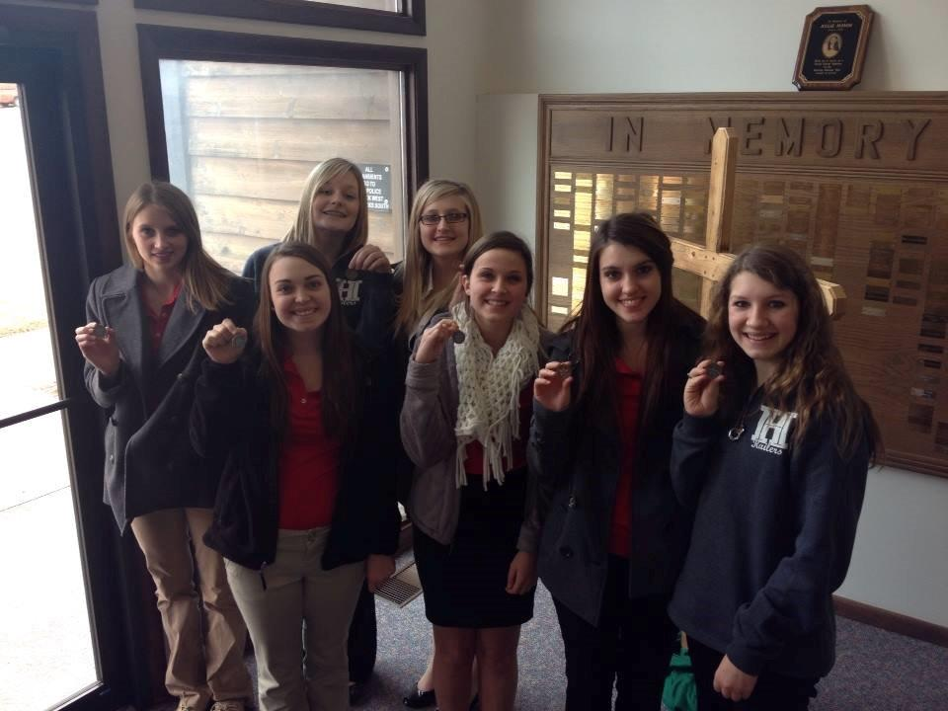
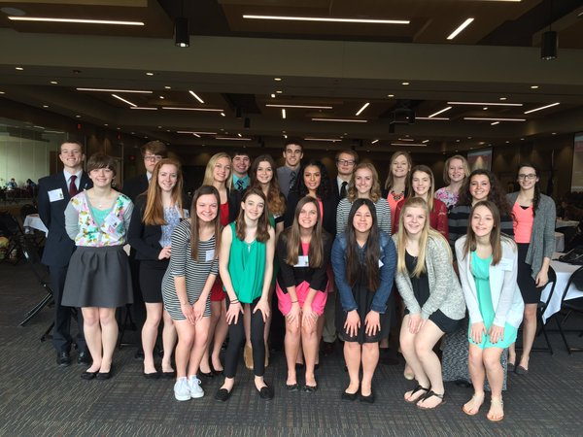
Competitions:
Sharing students in similar competitions
Help with students success
Cross Curricular

Slide 13
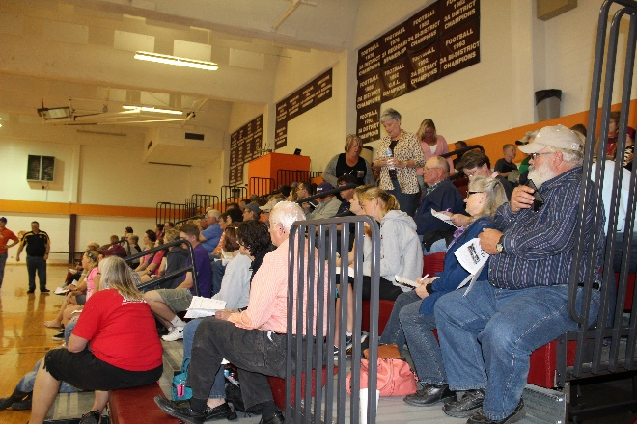
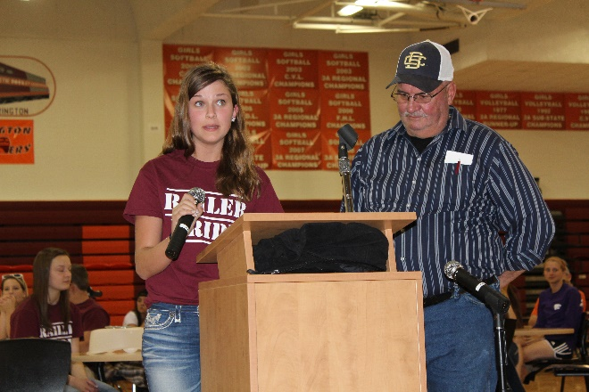
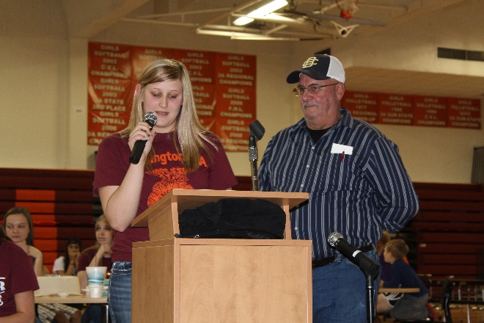
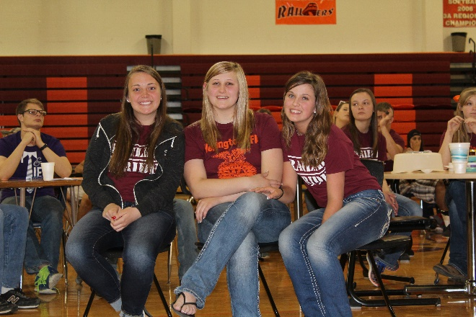
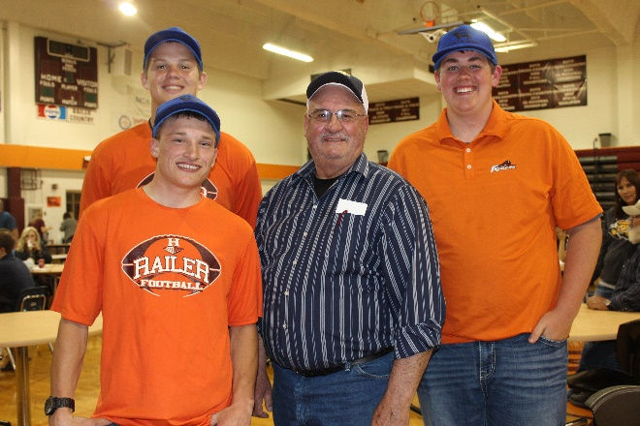
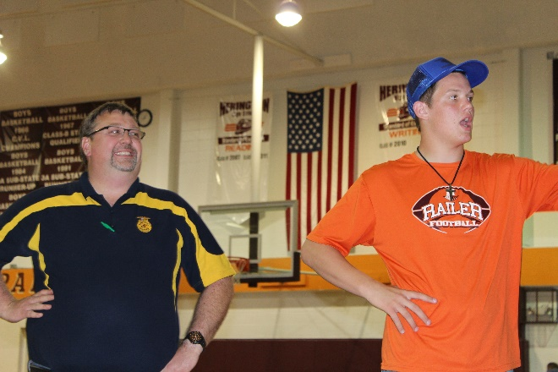
Fundraising
Year One:
Candles
Donuts
Fruit Sale
Chinses Supper
Year Two:
Combined our efforts
Soup Supper
Fruit Sale
Labor Auction
Disc Golf Tournament
Year Three:
Meat sticks
Fruit Sale
Labor Auction
Disc Golf Tournament

Slide 14
Roadblocks
Roadblock | Solutions
Core Teachers | Including them on our success and helping them realize they are part of the success of the student.
Missing Assignment | Advanced notice sheets Homework time at conferences(WIFI connections)
Fundraising | Combined all the fundraising together
Money from District | Presentations to the board, marketing our programs to show importance of these programs.

Slide 15
Questions:

